Slide 1
Understanding Cryptography
So we can break IT

Slide 2
Block vs stream
Generally, ciphers come in two forms:
Block cipher
Stream cipher
Block ciphers convert data in ‘n bit’ blocks
Output is a fixed length
Stream ciphers convert data one byte at a time
Output is the same length as input
Notes:
Plain text length for Block ciphers must be a multiple of the block size

Slide 3
Block ciphers
To actually encrypt or decrypt a message requires a “mode of operation” such as:
Electronic code book mode (ECB) *simplest
Cipher Block Chaining (CBC)
…and others
Examples of ECB could be:
Caesar cipher with 1-character “blocks"
Or generally, everything that has a code book.
Notes:
We usually use other modes of operation, which include an initialization vector and some kind of feedback, so that every block of every message is encrypted a different way.
https://crypto.stackexchange.com/questions/5333/difference-between-stream-cipher-and-block-cipher
https://www.geeksforgeeks.org/difference-between-block-cipher-and-stream-cipher/

Slide 4
For example…
Plain Text:
D E C A F
Cypher Text:
A G F E D C E G A
 | A | B | C | D | E | F | G | H
A | A | B | C | D | E | F | G | H
B | B | C | D | E | F | G | H | A
C | C | D | E | F | G | H | A | B
D | D | E | F | G | H | A | B | C
E | E | F | G | H | A | B | C | D
F | F | G | H | A | B | C | D | E
G | G | H | A | B | C | D | E | F
H | H | A | B | C | D | E | F | G

Slide 5
For example…
Plain Text:
D E C A F
Cypher Text:
A G F E D C E G A
 | A | B | C | D | E | F | G | H
A | A | B | C | D | E | F | G | H
B | B | C | D | E | F | G | H | A
C | C | D | E | F | G | H | A | B
D | D | E | F | G | H | A | B | C
E | E | F | G | H | A | B | C | D
F | F | G | H | A | B | C | D | E
G | G | H | A | B | C | D | E | F
H | H | A | B | C | D | E | F | G

Slide 6
For example…
Plain Text:
D E C A F
Cypher Text:
A G F E D C E G A
 | A | B | C | D | E | F | G | H
A | A | B | C | D | E | F | G | H
B | B | C | D | E | F | G | H | A
C | C | D | E | F | G | H | A | B
D | D | E | F | G | H | A | B | C
E | E | F | G | H | A | B | C | D
F | F | G | H | A | B | C | D | E
G | G | H | A | B | C | D | E | F
H | H | A | B | C | D | E | F | G

Slide 7
For example…
Plain Text:
D E C A F
Cypher Text:
D
A G F E D C E G A
 | A | B | C | D | E | F | G | H
A | A | B | C | D | E | F | G | H
B | B | C | D | E | F | G | H | A
C | C | D | E | F | G | H | A | B
D | D | E | F | G | H | A | B | C
E | E | F | G | H | A | B | C | D
F | F | G | H | A | B | C | D | E
G | G | H | A | B | C | D | E | F
H | H | A | B | C | D | E | F | G

Slide 8
For example…
Plain Text:
D E C A F
Cypher Text:
D C
A G F E D C E G A
 | A | B | C | D | E | F | G | H
A | A | B | C | D | E | F | G | H
B | B | C | D | E | F | G | H | A
C | C | D | E | F | G | H | A | B
D | D | E | F | G | H | A | B | C
E | E | F | G | H | A | B | C | D
F | F | G | H | A | B | C | D | E
G | G | H | A | B | C | D | E | F
H | H | A | B | C | D | E | F | G

Slide 9
For example…
Plain Text:
D E C A F
Cypher Text:
D C H
A G F E D C E G A
 | A | B | C | D | E | F | G | H
A | A | B | C | D | E | F | G | H
B | B | C | D | E | F | G | H | A
C | C | D | E | F | G | H | A | B
D | D | E | F | G | H | A | B | C
E | E | F | G | H | A | B | C | D
F | F | G | H | A | B | C | D | E
G | G | H | A | B | C | D | E | F
H | H | A | B | C | D | E | F | G

Slide 10
For example…
Plain Text:
D E C A F
Cypher Text:
D C H E
A G F E D C E G A
 | A | B | C | D | E | F | G | H
A | A | B | C | D | E | F | G | H
B | B | C | D | E | F | G | H | A
C | C | D | E | F | G | H | A | B
D | D | E | F | G | H | A | B | C
E | E | F | G | H | A | B | C | D
F | F | G | H | A | B | C | D | E
G | G | H | A | B | C | D | E | F
H | H | A | B | C | D | E | F | G

Slide 11
For example…
Plain Text:
D E C A F
Cypher Text:
D C H E A
A G F E D C E G A
 | A | B | C | D | E | F | G | H
A | A | B | C | D | E | F | G | H
B | B | C | D | E | F | G | H | A
C | C | D | E | F | G | H | A | B
D | D | E | F | G | H | A | B | C
E | E | F | G | H | A | B | C | D
F | F | G | H | A | B | C | D | E
G | G | H | A | B | C | D | E | F
H | H | A | B | C | D | E | F | G

Slide 12
For example…
Plain Text:
Cypher Text:
D C H E A
A G F E D C E G A
 | A | B | C | D | E | F | G | H
A | A | B | C | D | E | F | G | H
B | B | C | D | E | F | G | H | A
C | C | D | E | F | G | H | A | B
D | D | E | F | G | H | A | B | C
E | E | F | G | H | A | B | C | D
F | F | G | H | A | B | C | D | E
G | G | H | A | B | C | D | E | F
H | H | A | B | C | D | E | F | G

Slide 13
For example…
Plain Text:
D
Cypher Text:
D C H E A
A G F E D C E G A
 | A | B | C | D | E | F | G | H
A | A | B | C | D | E | F | G | H
B | B | C | D | E | F | G | H | A
C | C | D | E | F | G | H | A | B
D | D | E | F | G | H | A | B | C
E | E | F | G | H | A | B | C | D
F | F | G | H | A | B | C | D | E
G | G | H | A | B | C | D | E | F
H | H | A | B | C | D | E | F | G

Slide 14
For example…
Plain Text:
D E
Cypher Text:
D C H E A
A G F E D C E G A
 | A | B | C | D | E | F | G | H
A | A | B | C | D | E | F | G | H
B | B | C | D | E | F | G | H | A
C | C | D | E | F | G | H | A | B
D | D | E | F | G | H | A | B | C
E | E | F | G | H | A | B | C | D
F | F | G | H | A | B | C | D | E
G | G | H | A | B | C | D | E | F
H | H | A | B | C | D | E | F | G

Slide 15
For example…
Plain Text:
D E C
Cypher Text:
D C H E A
A G F E D C E G A
 | A | B | C | D | E | F | G | H
A | A | B | C | D | E | F | G | H
B | B | C | D | E | F | G | H | A
C | C | D | E | F | G | H | A | B
D | D | E | F | G | H | A | B | C
E | E | F | G | H | A | B | C | D
F | F | G | H | A | B | C | D | E
G | G | H | A | B | C | D | E | F
H | H | A | B | C | D | E | F | G

Slide 16
For example…
Plain Text:
D E C A
Cypher Text:
D C H E A
A G F E D C E G A
 | A | B | C | D | E | F | G | H
A | A | B | C | D | E | F | G | H
B | B | C | D | E | F | G | H | A
C | C | D | E | F | G | H | A | B
D | D | E | F | G | H | A | B | C
E | E | F | G | H | A | B | C | D
F | F | G | H | A | B | C | D | E
G | G | H | A | B | C | D | E | F
H | H | A | B | C | D | E | F | G

Slide 17
For example…
Plain Text:
D E C A F
Cypher Text:
D C H E A
A G F E D C E G A
 | A | B | C | D | E | F | G | H
A | A | B | C | D | E | F | G | H
B | B | C | D | E | F | G | H | A
C | C | D | E | F | G | H | A | B
D | D | E | F | G | H | A | B | C
E | E | F | G | H | A | B | C | D
F | F | G | H | A | B | C | D | E
G | G | H | A | B | C | D | E | F
H | H | A | B | C | D | E | F | G

Slide 18
Stream cipher
Maps k-bit keys and arbitrary length plaintexts to same arbitrary length ciphertext
If a part of the plaintext repeats, the corresponding ciphertext is not the same
Different parts of the message will be encrypted in different ways.
See the German “Enigma” machine
Stream ciphers can be:
Synchronous stream ciphers
Asynchronous stream ciphers
Notes:
Synchronous stream ciphers - work by producing a keystream from the actual key (and maybe an initialization vector) and then simply XOR-ing it with the message
Asynchronous stream ciphers - vary the encryption of future parts of the message depending on previous parts.
You should never reuse a key (and IV, if applicable) of a synchronous stream cipher (which includes block ciphers in streaming modes) for different messages, since this can lead to compromises. (And even for the same message it will show that you repeated a message.)

Slide 19
TLDR
Block
Stream
Block Cipher Converts the plain text into cipher text by taking plain text’s block at a time.
Block cipher uses either 64 bits or more than 64 bits.
In block cipher, reverse encrypted text is hard.
Stream Cipher Converts the plaint text into cipher text by taking 1 byte of plain text at a time.
Stream cipher uses 8 bits.
While in stream cipher, reverse encrypted text is easy.

Slide 20
Initialization vector
Also known as a “Starting Variable”
a fixed-size input to a cryptographic function
typically required to be random or pseudorandom
Randomization is crucial for encryption
Keeps attackers from working out patterns
For block ciphers, the use of an IV is required by most modes of operation
If the IV is non-repeating, the IV is commonly called a nonce (number used once)

Slide 21
Ivs are not secret
This is because the IV may be derived from a common state
A fancy way of saying that the IV is often derived from the message

Slide 22
Keys vs IVs
A key is something you keep secret.
Anyone who knows your key can decrypt any data you've encrypted with it
Symmetric key cryptography
Anyone with the private key can work out the public key
Asymmetric key cryptography
An IV or initialization vector is just the initial value used to start some iterated process
Notes:
Cryptographic hash functions typically have a fixed IV, which is just an arbitrary constant which is included in the hash function specification and is used as the initial hash value before any data is fed in
https://crypto.stackexchange.com/questions/3965/what-is-the-main-difference-between-a-key-an-iv-and-a-nonce

Slide 23
AES encryption
Advanced Encryption Standard
Block cipher
Became a federal government standard on May 26, 2002
The first and only publicly accessible cipher approved by the National Security Agency

Slide 24
features
Symmetric key symmetric block cipher
128-bit data, 128/192/256-bit keys
Stronger and faster than Triple-DES
Provide full specification and design details
Software implementable in C and Java

Slide 25
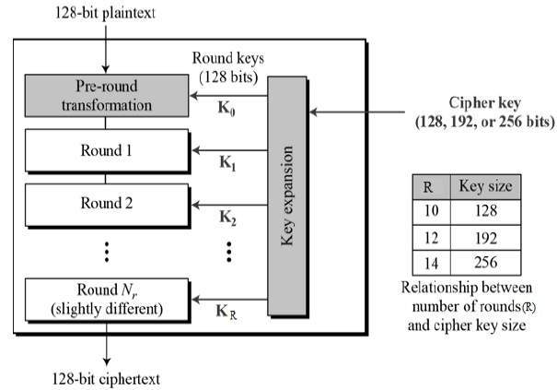
Operation of AES
Notes:
https://www.tutorialspoint.com/cryptography/advanced_encryption_standard.htm

Slide 26
rounds
Each round has 4 subprocesses
Byte Substitution (SubBytes)
Shiftrows
MixColumns
Addroundkey
Notes:
Byte Substitution (SubBytes)
The 16 input bytes are substituted by looking up a fixed table (S-box) given in design. The result is in a matrix of four rows and four columns.
Shiftrows
Each of the four rows of the matrix is shifted to the left. Any entries that ‘fall off’ are re-inserted on the right side of row. Shift is carried out as follows −
First row is not shifted.
Second row is shifted one (byte) position to the left.
Third row is shifted two positions to the left.
Fourth row is shifted three positions to the left.
The result is a new matrix consisting of the same 16 bytes but shifted with respect to each other.
MixColumns
Each column of four bytes is now transformed using a special mathematical function. This function takes as input the four bytes of one column and outputs four completely new bytes, which replace the original column. The result is another new matrix consisting of 16 new bytes. It should be noted that this step is not performed in the last round.
Addroundkey
The 16 bytes of the matrix are now considered as 128 bits and are XORed to the 128 bits of the round key. If this is the last round then the output is the ciphertext. Otherwise, the resulting 128 bits are interpreted as 16 bytes and we begin another similar round.

Slide 27
Modes of operation
ECB mode: Electronic Code Book mode
CBC mode: Cipher Block Chaining mode
CFB mode: Cipher FeedBack mode
OFB mode: Output FeedBack mode
CTR mode: Counter mode
https://www.highgo.ca/2019/08/08/the-difference-in-five-modes-in-the-aes-encryption-algorithm/

Slide 28
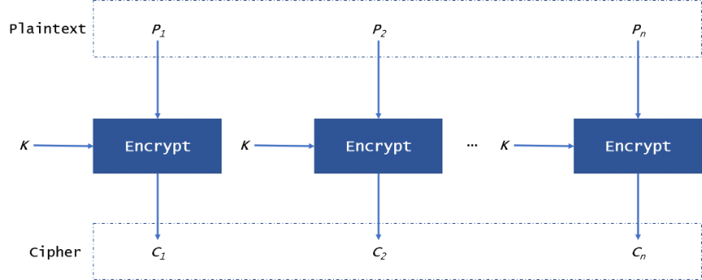
Ecb Mode
Notes:
https://www.highgo.ca/2019/08/08/the-difference-in-five-modes-in-the-aes-encryption-algorithm/

Slide 29
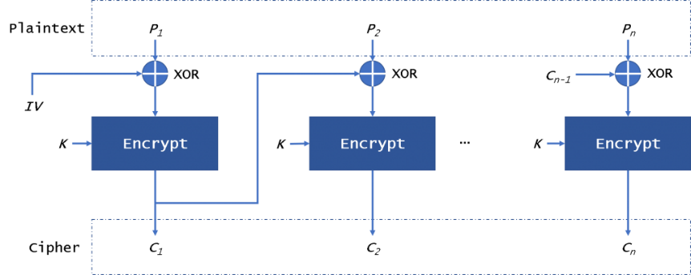
CBC mode
Notes:
The CBC (Cipher Block Chaining) mode provides this by using an initialization vector – IV. The IV has the same size as the block that is encrypted. In general, the IV usually is a random number, not a nonce.

Slide 30
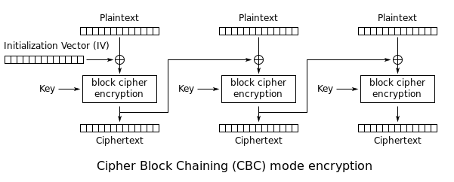
CBC mode
Notes:
First, we will use the plaintext block xor with the IV. Then CBC will encrypt the result to the ciphertext block. In the next block, we will use the encryption result to xor with plaintext block until the last block. In this mode, even if we encrypt the same plaintext block, we will get a different ciphertext block.

Slide 31
CFB mode
Notes:
The CFB (Cipher FeedBack) mode of operation allows the block encryptor to be used as a stream cipher. It also needs an IV.
First, CFB will encrypt the IV, then it will xor with plaintext block to get ciphertext. Then we will encrypt the encryption result to xor the plaintext. Because this mode will not encrypt plaintext directly, it just uses the ciphertext to xor with the plaintext to get the ciphertext. So in this mode, it doesn’t need to pad data.

Slide 32
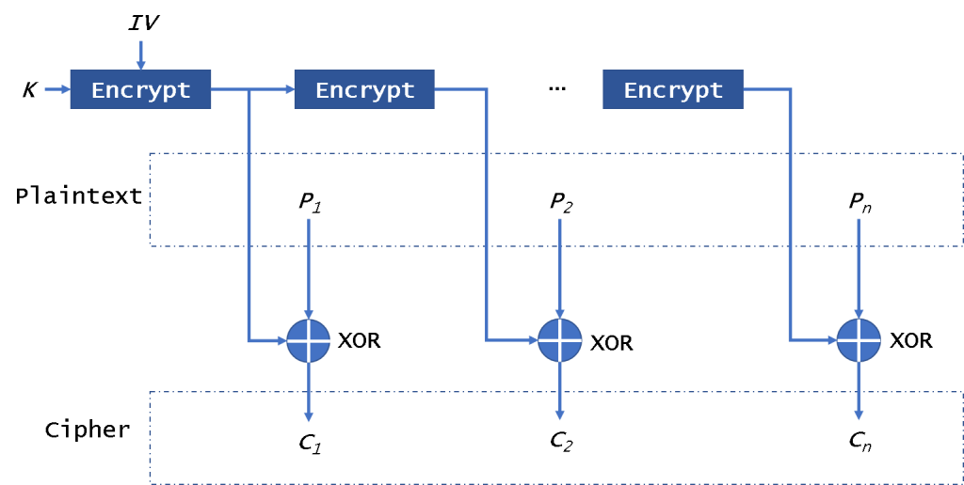
OFB mode
Notes:
In this mode, it will encrypt the IV in the first time and encrypt the per-result. Then it will use the encryption results to xor the plaintext to get ciphertext. It is different from CFB, it always encrypts the IV.

Slide 33
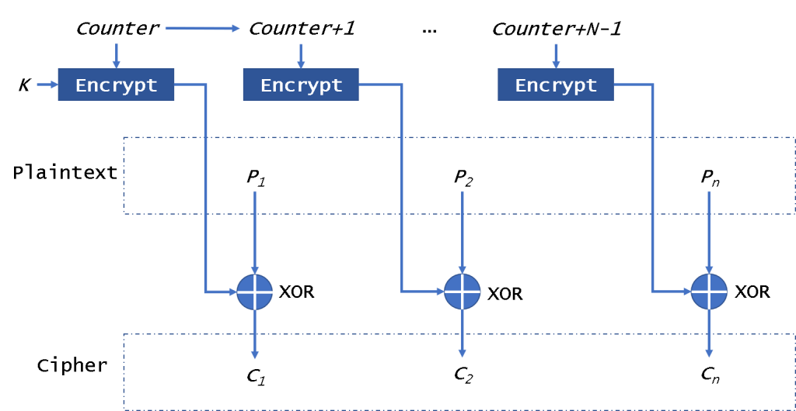
CTR mode
Notes:
Uses a counter instead of an IV

Slide 34
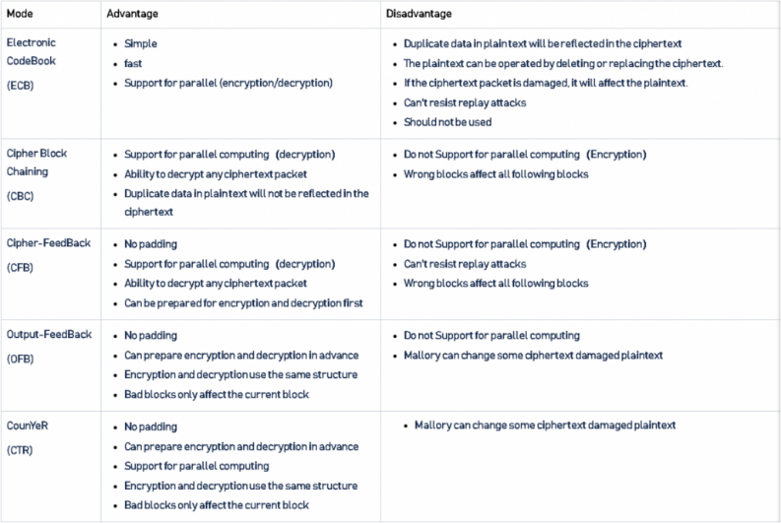
Summary

Slide 35
RSA Encryption
Asymmetric Encryption
Two keys
Public
Private
Assumes finding the prime factors of a large composite number is difficult

Slide 36
How does it work?
Choose two different large prime numbers: p and q
Calculate n = pq
Calculate the totient: T=(p-1)(q-1)
Choose an integer e such that 1 < e < T(n) and e shares no factors other than 1 with T(n)
e is “coprime” with T(n)
Compute d so that the relation $de≡1$
e is released as the public key exponent
d is kept as the private key exponent
Notes:
Totient: In number theory, the totient of a positive integer is the number of positive integers smaller than n which are coprime to n (they share no factors except 1).
Example: T(8) = 4 because there are 4 prime numbers smaller than 8 when do not share any factors with 8

Slide 37
Encryption
Alice gives her public key n & e to Bob and keeps her private key secret.
Bob wants to send message M to Alice.
First he turns M into a number m smaller than n by using an agreed-upon reversible protocol known as a padding scheme. He then computes the ciphertext c
$c=m^{e} mod(n)$

Slide 38
decryption
Alice can recover m from c by using her private key d in the following procedure:
$m=c^{d} mod n$
Given m, she can recover the original distinct prime numbers, applying the Chinese remainder theorem to these two congruences yields

Slide 39
A working example

Slide 40
Choose two random prime numbers
p = 61
q = 53
Compute n
n =?
Notes:
n = p * q

Slide 41
Choose two random prime numbers
p = 61
q = 53
Compute n
n = (61 * 53) = 3233
Notes:
n = p * q

Slide 42
p = 61, q = 53, n = 3233
Compute the totient
T = (p-1)(q-1) = ?
Notes:
T = (p-1)(q-1) =

Slide 43
p = 61, q = 53, n = 3233
Compute the totient
T = (p-1)(q-1) = 3120
Choose e > 1 and coprime to 3120
e = 17

Slide 44

p = 61, q = 53, n = 3233, T(n) = 3120, e = 17
Choose d to satisfy $de mod(T\left(n\right))≡1$
d =?
Notes:
d = 2753

Slide 45

p = 61, q = 53, n = 3233, T(n) = 3120, e = 17
Choose d to satisfy $de mod(T\left(n\right))≡1$
d = 2753

Slide 46
Public key:
n = 3233, e = 17
Private key:
n = 3233, d = 2753
Notes:
897985458377697676

Slide 47
Decrypt the following
2557
What happens when you try to encrypt/decrypt 8192?

Slide 48
Now then…
RSA relies on not being able to factor n into prime factors.
(3233) is easy for a computer
RSA keys are typically 1024, 2048, or 4096 bits in length, so we use two primes of approximately half that length each
Most modern uses are typically 2048 or 4096 as factoring 1024-bit semiprimes is difficult but feasible
RSA gets its strength from the difficulty in figuring out which prime numbers were used.
So don’t just use a list of “large prime numbers”

Slide 49
So…
How do we get large prime numbers without using a list?
…

Slide 50
So…
How do we get large prime numbers without using a list?
…wait for it…

Slide 51
So…
How do we get large prime numbers without using a list?
…wait for it…
Random numbers

Slide 52
OpenSSL does it this way:
Generate a random 512 bit odd number, say p
Test to see if p is prime;
if it is, return p;
this is expected to occur after testing about log(p)/2 candidates (~177)
Otherwise set p=p+2, goto 2

Slide 53
Just trivia
The largest known prime number (as of January 2020)
$2^{82, 589, 933}−1$
has 24,862,048 digits when written in base 10
found by Patrick Laroche of the Great Internet Mersenne Prime Search (GIMPS)

