Slide 1
Physical Security

Slide 2
Smart cards
typically a plastic credit card-sized card with an embedded integrated circuit
Patented in 1974

Slide 3
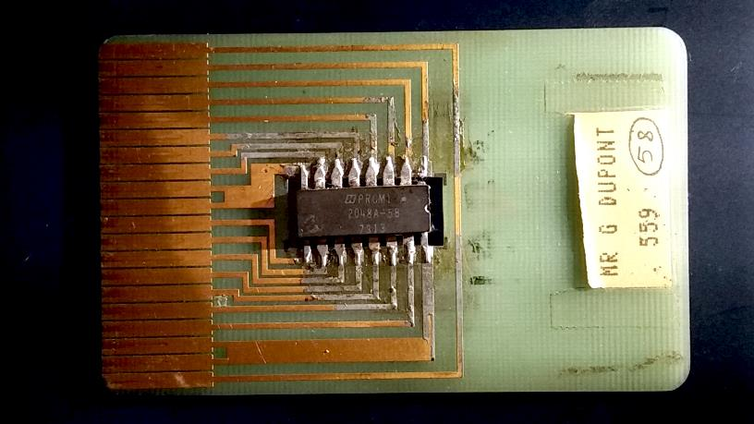
Notes:
1975 prototype
By ByB - Own work, CC BY-SA 4.0, https://commons.wikimedia.org/w/index.php?curid=42784498

Slide 4
Two categories
Contact
Have a contact area to provide electrical connectivity when inserted into a reader
Contactless
Communicate with and are powered by the reader through RF induction technology

Slide 5
Proximity Card
Previous generation technology
Operate on 125kHZ
Passive
Powered by radio frequency
Must be held close to reader
Active
Powered by battery
Range of ~6 feet

Slide 6
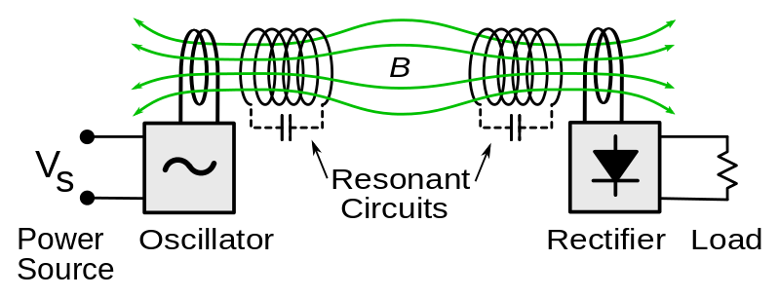
resonant inductive coupling
Notes:
Invented by Tesla (1890s)

Slide 7
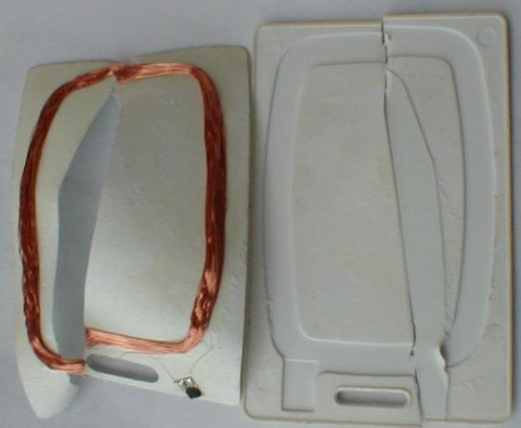

Slide 8
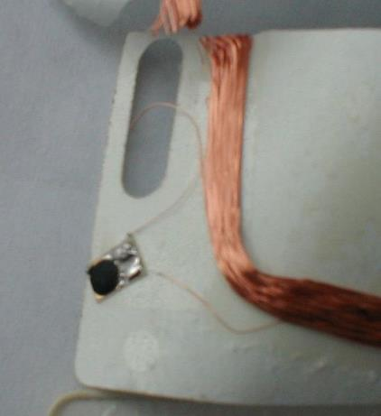

Slide 9
Contactless smart cards
contain read-only RFID called CSN (Card Serial Number) or UID
a re-writeable smart card microchip that can be transcribed via radio waves.

Slide 10
Official standard Range (MIFARE)
ISO/IEC 14443 – two standards: “A” and “B”
A
Up to 3.9”
B
Up to 1.6’

Slide 11
Competing standards
Maximum read range
17” – 18”
up to 4’ 11” (59”)

Slide 12
MIFARE
Trademark of NXP Semiconductors
Dutch global semiconductor manufacturer
a series of chips used in contactless smart cards and proximity cards

Slide 13
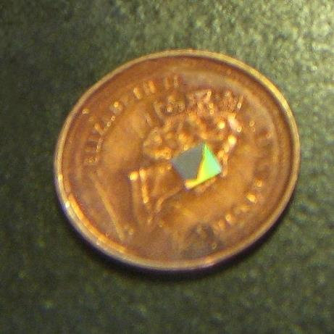

Slide 14
variations
MIFARE Classic
MIFARE Plus
MIFARE Ultralight
MIFARE DESFire
Notes:
MIFARE Classic
Employs a proprietary protocol security protocol for authentication and ciphering.
MIFARE Plus
Drop-in replacement for MIFARE Classic with certified security level (AES-128 based) and is fully backwards compatible with MIFARE Classic
MIFARE Ultralight
Low-cost ICs that are useful for high volume applications such as public transport, loyalty cards and event ticketing.
MIFARE DESFire
The DES in the name refers to the use of a DES, two-key 3DES, three-key 3DES and AES encryption; while Fire is an acronym for Fast, innovative, reliable, and enhanced. Subtypes: MIFARE DESFire EV1, MIFARE DESFire EV2.

Slide 15
MIFARE classic
Just a memory storage device
memory is divided into segments and blocks
simple security mechanisms for access control
1,024 bytes of data storage, split into 16 sectors
Each sector is protected by two different keys
4,096 bytes split into forty sectors
Uses Crypto-1 ciphering
Notes:
They are ASIC-based and have limited computational power (application-specific integrated circuit)
Each key can be programmed to allow operations such as reading, writing, increasing value blocks, etc. Also, the very first 16 bytes contain the serial number of the card and certain other manufacturer data and are read only. It uses an NXP proprietary security protocol (Crypto-1) for authentication and ciphering.

Slide 16
MIFARE Plus
Released in 2008
Replacement solution for the MIFARE Classic
Backwards compatible…(Good? Bad?)
Its highest security level uses 128-bit AES encryption
Notes:
MIFARE Plus, when used in older transportation systems that do not yet support AES on the reader side, still leaves an open door to attacks. Though it helps to mitigate threats from attacks that broke the Crypto-1 cipher through the weak random number generator, it does not help against brute force attacks and cryptoanalytic attacks

Slide 17
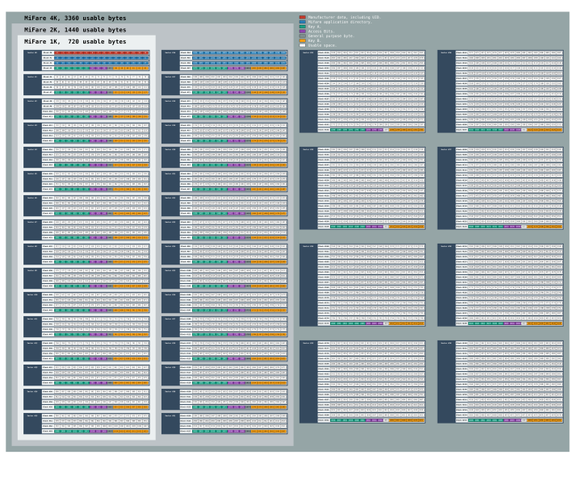

Slide 18
Crypto-1 cipher
a proprietary encryption algorithm created by NXP Semiconductors specifically for MIFARE RFID
Consists of:
one 48-bit feedback shift register for the main secret state of the cipher,
a linear function,
a two-layer 20-to-1 nonlinear function and
a 16-bit LFSR which is used during the authentication phase
Also serves as the pseudo random number generator on some card implementations
Notes:
LFSR- Linear-feedback shift register

Slide 19
By 2009, cryptographic research showed that:
"the security of this cipher is ... close to zero“
de Koning Gans, Gerhard; J.-H. Hoepman; F.D. Garcia (2008-03-15). "A Practical Attack on the MIFARE Classic" (PDF). 8th Smart Card Research and Advanced Application Workshop (CARDIS 2008), LNCS, Springer.
Courtois, Nicolas T.; Karsten Nohl; Sean O'Neil (2008-04-14). "Algebraic Attacks on the Crypto-1 Stream Cipher in MiFare Classic and Oyster Cards". Cryptology ePrint Archive.
Nohl, Karsten; David Evans; Starbug Starbug; Henryk Plötz (2008-07-31). "Reverse-engineering a cryptographic RFID tag". SS'08 Proceedings of the 17th conference on Security symposium. USENIX. pp. 185–193.
Garcia, Flavio D.; Gerhard de Koning Gans; Ruben Muijrers; Peter van Rossum, Roel Verdult; Ronny Wichers Schreur; Bart Jacobs (2008-10-04). "Dismantling MIFARE Classic" (PDF). 13th European Symposium on Research in Computer Security (ESORICS 2008), LNCS, Springer.
Garcia, Flavio D.; Peter van Rossum; Roel Verdult; Ronny Wichers Schreur (2009-03-17). "Wirelessly Pickpocketing a Mifare Classic Card" (PDF). 30th IEEE Symposium on Security and Privacy (S&P 2009), IEEE.
Notes:
The MIFARE Classic encryption Crypto-1 can be broken in about 200 seconds on a laptop from 2008, if approx. 50 bits of known (or chosen) key stream are available. This attack reveals the key from sniffed transactions under certain (common) circumstances and/or allows an attacker to learn the key by challenging the reader device.
The attack proposed in recovers the secret key in about 40 ms on a laptop. This attack requires just one (partial) authentication attempt with a legitimate reader.

