Slide 1
Ethical Hacking
Module 2- Case Studies

Slide 2
teardrop
DoS attack
Sends fragmented packets with (intentionally) incorrect reassembly offsets
Only works on OLD systems
Windows 3.1x, Windows 95, Windows NT
Linux kernel prior to 2.1.63.
Notes:
Teardrop Attack
One of the fields in an IP header is the “fragment offset” field, indicating the starting position, or offset, of the data contained in a fragmented packet relative to the data in the original packet. If the sum of the offset and size of one fragmented packet differs from that of the next fragmented packet, the packets overlap. When this happens, a server vulnerable to teardrop attacks is unable to reassemble the packets - resulting in a denial-of-service condition.

Slide 3
Ping of death
TCP/IP allows fragmentation
Hacker needs nothing except IP address
Notes:
One of the features of TCP/IP is fragmentation; it allows a single IP packet to be broken down into smaller segments. In 1996, attackers began to take advantage of that feature when they found that a packet broken down into fragments could add up to more than the allowed 65,536 bytes. Many operating systems didn't know what to do when they received an oversized packet, so they froze, crashed, or rebooted.
Ping of death attacks were particularly nasty because the identity of the attacker sending the oversized packet could be easily spoofed. Still, many Web sites continue to block Internet Control Message Protocol

Slide 4
heartbleed
The Heartbleed bug was a serious flaw in OpenSSL
a software library for applications that secure communications
Widely used by Internet servers, including the majority of HTTPS websites
Notes:
OpenSSL- a software library for applications that secure communications over computer networks against eavesdropping or need to identify the party at the other end.

Slide 5
heartbleed
The SSL standard includes a heartbeat option
It's possible to send a message that tricks the computer at the other end into divulging secret information
Specifically, contents of the server's memory
Notes:
Here's how it worked: the SSL standard includes a heartbeat option, which allows a computer at one end of an SSL connection to send a short message to verify that the other computer is still online and get a response back. Researchers found that it's possible to send a cleverly formed, malicious heartbeat message that tricks the computer at the other end into divulging secret information. Specifically, a vulnerable computer can be tricked into transmitting the contents of the server's memory, known as RAM.
Attackers using the technique can "sort through that information by doing pattern matching to try to find secret keys, passwords, and personal information like credit card numbers."

Slide 6
heartbleed
Notes:
https://www.vox.com/2014/6/19/18076318/heartbleed

Slide 7
heartbleed
Notes:
https://www.vox.com/2014/6/19/18076318/heartbleed

Slide 8
heartbleed
In the real Heartbleed attack, the attacker can ask for up to 64,000 characters of plain text
And it doesn’t need to only ask once
There is no message limit

Slide 9
floods
Ping
HTTP
DNS
UDP

Slide 10
Question(s)
Most of these attacks are used against common ‘standard’ protocols
How do you go about selecting a target?

Slide 11
answer
Fingerprinting
Footprinting

Slide 12
Our Shopping List
Internet
Domain names
Network blocks and subnets
IP addresses of externally facing systems, TCP/UDP services, ACL’s
IDS/IPS
Enumeration (users/groups, banners, etc.)
Intranet
Protocols in use
Internal domain names
Network blocks
IP addresses
IDS/IPS
Enumeration
Notes:
McClure, Scambray & Kurtz (2012). Hacking Exposed: Network Security Secrets and Solutions (7ed). McGraw-Hill. P.9

Slide 13
footprinting
An organization’s attack surface is the set of exposed interfaces to the external world.
These interfaces may be physical or logical:
A door
An open network port
An employee
Etc.

Slide 14
Ask
C:\Users\Richard>nslookup
Default Server: dnsr1.sbcglobal.net
Address: 68.94.156.1
> cnn.com
Server: dnsr1.sbcglobal.net
Address: 68.94.156.1
Non-authoritative answer:
Name: cnn.com
Addresses: 157.166.226.25
157.166.224.26
157.166.224.25
157.166.255.19
157.166.255.18
157.166.226.26
> set type=mx
> cnn.com
Server: dnsr1.sbcglobal.net
Address: 68.94.156.1
Non-authoritative answer:
cnn.com MX preference = 10, mail exchanger = atlmail5.turner.com
cnn.com MX preference = 10, mail exchanger = atlmail3.turner.com
cnn.com MX preference = 10, mail exchanger = nycmail2.turner.com
cnn.com MX preference = 10, mail exchanger = nycmail1.turner.com
cnn.com MX preference = 10, mail exchanger = lonmail1.turner.com
cnn.com MX preference = 10, mail exchanger = hkgmail1.turner.com
Even meaningful server names reveal information

Slide 15
nslookup
Name Server Lookup
Finds name server information for domains by querying the Domain Name System
Identifies which DNS server the computer is currently configured to use for its DNS lookups

Slide 16
Mx record
Mail eXchanger record
Specifies the mail server responsible for accepting email messages on behalf of a domain name

Slide 17
Worth a try
This attempts a zone transfer (list the entire contents of the name server)
Disabling zone transfers is a pretty standard security measure
Some domains overlook it

Slide 18
What addresses?
IP address space is assigned by an authority called a registrar and the assignments are public information
If you know any address belonging to an organization, you can likely find out their entire netblock

Slide 19
Us internal address blocks
10.0.0.0/8 IP addresses
10.0.0.0 – 10.255.255.255
172.16.0.0/12 IP addresses
172.16.0.0 – 172.31.255.255
192.168.0.0/16 IP addresses
192.168.0.0 – 192.168.255.255

Slide 20
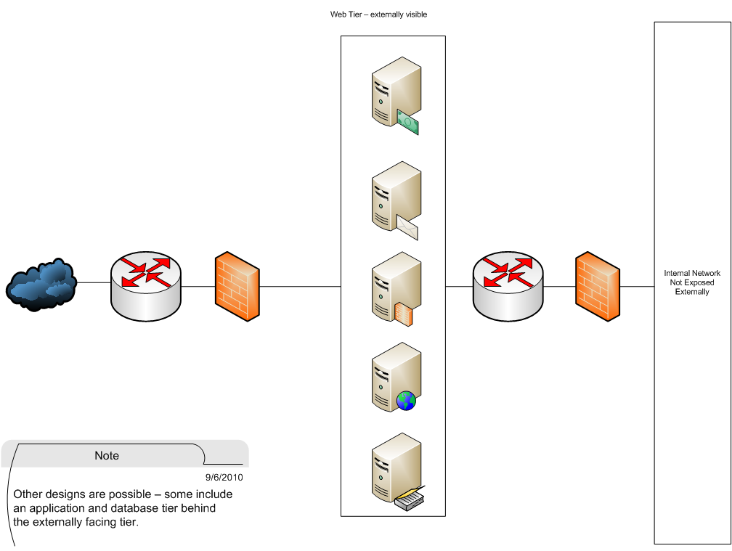
Finding Hosts
On a well-designed network, only the required hosts are visible to the Internet but not all networks are well-designed (or well-implemented on an ongoing basis).

Slide 21
Finding Hosts
WARNING
Do not scan a network unless you are authorized to do so
Notes:
While often not strictly illegal, it may attract attentions that you will not welcome.

Slide 22
Finding Hosts
There are many tools for scanning networks but we will cover nmap
Open Source project
Available as a download for multiple platforms at www.insecure.org

Slide 23
Finding Hosts
A rather stealthy technique is to perform a reverse lookup on all IP addresses in the assigned address range.
Manually, this could take quite a while but nmap will do it automatically for you
nmap –sL www.example.com/16
This command will do a reverse DNS lookup on all hosts in the class-B network that contains www.example.com
On a busy network, this will look like just normal traffic

Slide 24
Summary
Thus far, using only normal Internet queries, we know
CNN’s website address
Its nameservers
Its mail exchangers
Its assigned netblock
So, we have a pretty decent idea of the Internet footprint of CNN

Slide 25
fingerprinting
Fingerprinting carries the recon process further by trying to identify the specific services and platforms used by an organization
An important tool in this process is the port scan with version detection

Slide 26
Pop quiz
Ports
What layer are they?
How many are there?
How do they relate to applications?

Slide 27
The TCP/IP Stack
Layer 5 Application Layer
HTTP SMTP DNS SSH …
Layer 4 Transport Layer
TCP UDP SCTP
Layer 3 Network (Routing) Layer
IP ICMP DHCP ARP
Layer 2 Data Link Layer
Depends on underlying network.
Layer 1 Physical Layer
Depends on underlying network.
Notes:
http://en.wikipedia.org/wiki/Stream_Control_Transmission_Protocol

Slide 28
Port Scan?
A port scan basically attempts to connect to a host or set of hosts on every available (or possible port)
It is useful for determining what network services are actually running and visible rather than those that are supposed to be running and visible

Slide 29
Can they do harm?
Theoretically, no
Practically, they can expose problems with the implementation of the network stack
For example, embedded network stacks may have small connection tables and scans may overflow them
Usual result is to crash the device
This is theft as it deprives the owner of the use of their property

Slide 30
nmap port states
Nmap classifies ports into states based on their accessibility. The most common states are:
Open – the port is accessible and some application is accepting connections on it
Closed – the port is accessible but there is no application listening on it (the host returned a RST)
Filtered – nmap cannot determine whether the port is open or closed because the probes are being filtered (the host returned nothing)

Slide 31
Open Port
Fyodor, NMAP Network Scanning, p. 97

Slide 32
Closed/Filtered
Which response is better from a security perspective?
Fyodor, NMAP Network Scanning, p. 98

Slide 33
Basic scan
C:\Program Files\Nmap>nmap scanme.nmap.org
Starting Nmap 5.21 ( http://nmap.org ) at 2010-09-07 09:59 Eastern Daylight Time
Nmap scan report for scanme.nmap.org (64.13.134.52)
Host is up (0.085s latency).
Not shown: 993 filtered ports
PORT STATE SERVICE
22/tcp open ssh
25/tcp closed smtp
53/tcp open domain
70/tcp closed gopher
80/tcp open http
113/tcp closed auth
31337/tcp closed Elite
Nmap done: 1 IP address (1 host up) scanned in 14.22 seconds
What kind of server is this?

Slide 34
Basic scan
C:\Program Files\Nmap>nmap scanme.nmap.org
Starting Nmap 5.21 ( http://nmap.org ) at 2010-09-07 09:59 Eastern Daylight Time
Nmap scan report for scanme.nmap.org (64.13.134.52)
Host is up (0.085s latency).
Not shown: 993 filtered ports
PORT STATE SERVICE
22/tcp open ssh
25/tcp closed smtp
53/tcp open domain
70/tcp closed gopher
80/tcp open http
113/tcp closed auth
31337/tcp closed Elite
Nmap done: 1 IP address (1 host up) scanned in 14.22 seconds
What kind of server is this?
What would you say if it was supposed to only be a web server?

Slide 35
Things to Note
A basic scan (no switches) does a basic scan but you need to understand the defaults
Host up/down – ping the host, send an SYN to port 443, send an ACK to port 80, send a ICMP timestamp request
What if the firewall blocks ICMP?
Notes:
443- HTTPS
80- HTTP

Slide 36
Stealth?
-sS is called the “stealth” scan because it doesn’t open a full connection on the port
SYN sent via raw packet construction (i.e., doesn’t use the O/S API)
Send a SYN
If receive a SYN/ACK, host network stack responds with a RST
Networking equivalent of “WTF? I wasn’t trying to talk to you!”
Beware, even many consumer grade firewalls can detect a lot of SYN’s coming on sequential ports from the same SRC address

Slide 37
Version Detection
While standards specify the core of what protocols must do, each implementer has some freedom to make decisions
These decisions create characteristics (a “fingerprint”) that can be used to identify versions
Some services also display their information in a banner

Slide 38
Banner Grabbing
Too Much Information?

Slide 39
Use the same techniques
Scan your own networks and fix the vulnerabilities you find
Rogue servers
Rogue applications
Firewall configuration problems
IDS/IPS that doesn’t

Slide 40
Stop them at the perimeter
Default DENY is the firewall policy of necessity
If it’s not explicitly authorized, block it
Use effective change management to make sure your configurations don’t soften over time

Slide 41
Misinform
What if your Windows box told an attacker it was a Linux box?
Banner spoofing and other such techniques can confuse a scanner
Be careful; it is an arms race and adversaries will adapt and innovate

Slide 42
Detection and Response
Black holes
Reserve a portion of your address space as unused
Since there are no services running on that address, any traffic to it is either an error or a scan
Honeynets and Honeypots
Provide virtual or real network services to decoy attackers and study their techniques
Integrate with your Incident Response plan
Beware of the “continuous alarm” syndrome

