Slide 1
Ethical Hacking
Module 3

Slide 2
A brief tangent
Virtual Memory

Slide 3
Memory Management
The operating system must allocate memory to multiple processes in a multiprogramming environment.
Physically, memory is just an array of bytes.
The operating system must make sense out of that.

Slide 4
Memory Partitioning
Fixed partitioning: If you don’t have a big enough free partition, cannot run.
Variable: most flexible, but leads to…
Memory fragmentation
Free memory space is fragmented.
JGrasp
JGrasp
Word
Word
O.S.
O.S.
O.S.
O.S.

Slide 5
Allocation Strategies
First fit: fastest, but can leave small “holes”
Best fit: always leaves small holes.
Biggest fit: may leave an area big enough to be useful
First fit / best fit: The remaining area is unusably small.
Biggest fit: two potentially useful areas of memory are left.
New Program
JGrasp
JGrasp
JGrasp
New Program
O.S.
O.S.
O.S.

Slide 6
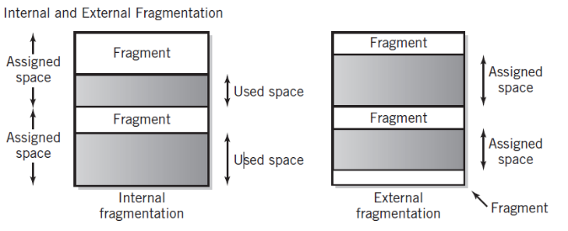
Internal and External Fragmentation
Internal fragmentation: Memory has been assigned, but is not being used.
External fragmentation: Memory is unassigned, but too small to be useful.

Slide 7
Memory Relocation
Programs are compiled and linked to specific starting addresses, often zero.
Addresses have to be adjusted (relocated) unless relative addressing is used.
This is part of memory management.
Next program must load here. Address is not predictable at link time.
JGrasp
Word
O.S.

Slide 8
Overlays
Programs are divided into small logical pieces for execution
Pieces are loaded into memory as needed
Overlays are managed by the application program, not the OS. (Messy!)

Slide 9
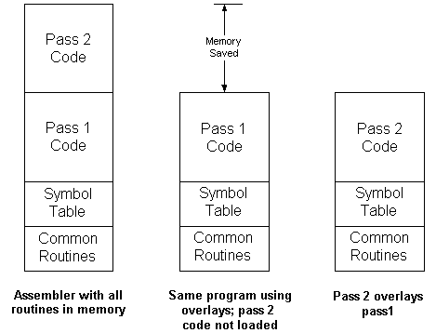
Why Overlays?

Slide 10
Usable and Unusable Address Spaces
4G
Unusable
Address Space
2G
Usable
Memory map: This computer has a 32-bit address space, but only 2 gigabytes of installed memory. The remaining two gigabytes are addressable, but not useful because there is no memory installed.

Slide 11
Virtual Memory
Virtual memory increases the apparent amount of memory by using far less expensive hard disk space
Provides for process separation (memory protection)
Demand paging: Pages brought into memory as needed
Page table: Keeps track of what is in memory and what is still out on hard disk

Slide 12
Transparent Virtual Memory
The programmer codes as though the entire logical address space were available.
Virtual memory is transparent to the programmer. (It’s there, but you can’t see it.)
The entire program and in-memory data is stored on disk.
Pieces of the program and data (pages) are read into main memory (page frames) as needed. This is demand paging.
Paging takes time.

Slide 13
Frames and Pages
 | Program | Memory
Unit | Pages | Frames
Address | Logical | Physical
Size | 2 to 4KB | Same as logical page
Amount | Address bits in effective address | Amount of installed memory

Slide 14
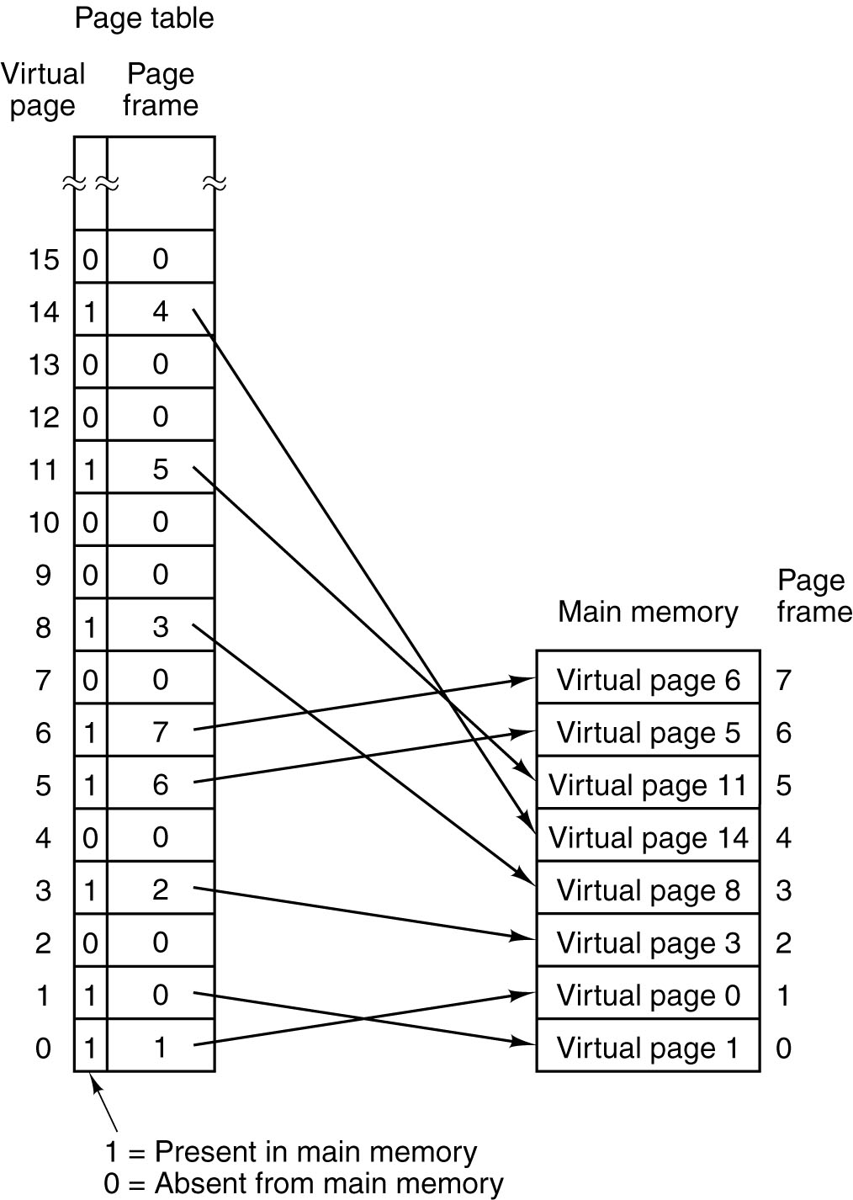
Frames and Pages
A possible mapping of
the 16 virtual pages
onto a main memory
with eight page frames.
Tanenbaum, Andrew, Structured Computer Organization, Fifth Edition Copyright © 2006 by Pearson Education, Inc.

Slide 15
Page Faults
Page Frame
Pages not in main memory:
page fault when accessed
1
2
3
4
5
6
7
8
9
10
11
6
4
8
10
1
2
7
Disk
1
2
3
4
5
6
7
8
9
10
11
Page file
Virtual Memory Pages

Slide 16
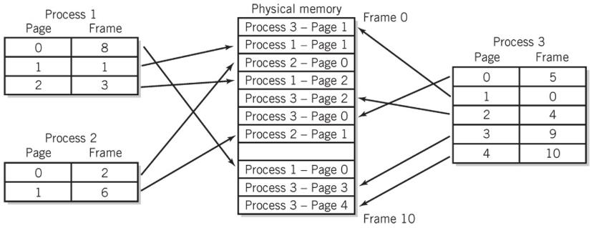
Mapping Multiple Processes

Slide 17
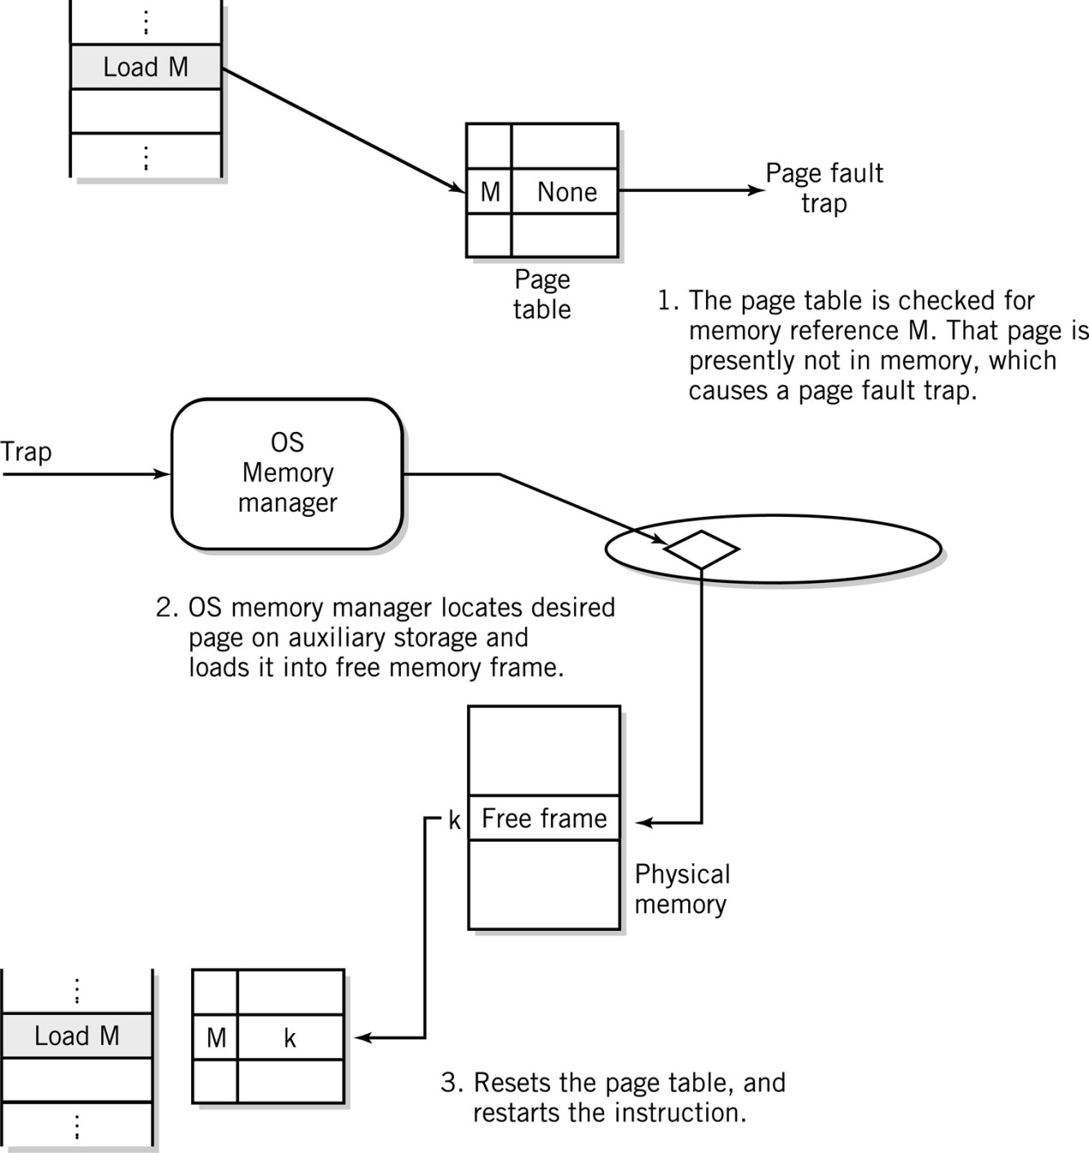
Steps in Handling a Page Fault

Slide 18
Implementation of Paging
A 32 KB main memory
divided up into eight
page frames of 4 KB each.

Slide 19
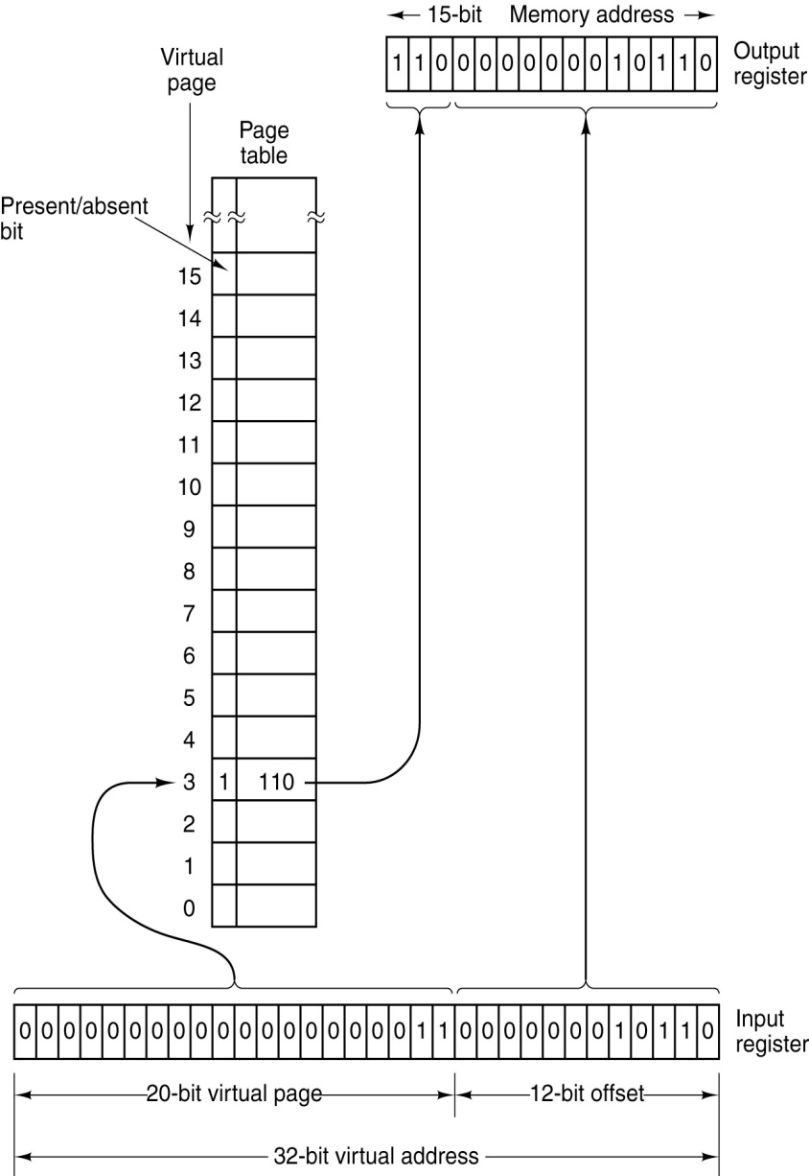
Address Mapping
Formation of a main memory (physical) address from a virtual address.
4K pages, so address within page is 12 bits; 2¹² = 4,096. This is called the offset.
The remainder of the virtual address (32 – 12 = 20) is the page number.
The page frame is looked up from the page table.
The offset is copied
To form a 15-bit physical address.

Slide 20
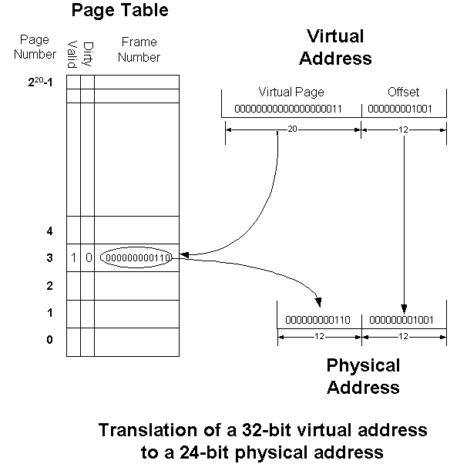
Dynamic Address Translation

Slide 21
Page Table Implementation
Associative memory improves access to the page table during the fetch-execute cycle
Addresses are assigned to each location as labels and stored in a translation lookaside buffer (TLB) table
May be stored in virtual memory

Slide 22
Locality of Reference
Temporal locality of reference: If a page has been used recently, it is likely to be used again “soon.”
Spatial locality of reference: If an area of memory is accessed, nearby areas are likely to be accessed “soon.”

Slide 23
Locality of Reference
Most memory references are confined to small region
Well-written program in small loop, procedure or function
Data likely in array and variables stored together
Working set: Number of pages sufficient to run program normally, i.e., satisfy locality of a particular program
Thrashing (bad) Too many page faults affect system performance

Slide 24
Page Replacement Algorithms
Page fault - page is not in memory and must be loaded from disk
May have to evict a page
Algorithms to manage page replacement
First-In, First-Out FIFO – Bélády’s Anomaly (1969) increasing number of pages results in more page faults
Least Recently Used LRU
Least Frequently Used LFU
Second Chance Replacement algorithms
Notes:
From Wikipedia, the free encyclopedia
In computer storage, Belady's anomaly states that it is possible to have more page faults when increasing the number of page frames while using FIFO method of frame management. Laszlo Belady demonstrated this in 1969. Previously, it was believed that an increase in the number of page frames would always provide the same number or fewer page faults.
In common computer memory management, information is loaded in specific sized chunks. Each chunk is referred to as a page. The central processor can only load a limited number of pages at a time. It requires a frame for each page it can load. A page fault occurs when a page is not found, and might need to be loaded from disk into memory.
When a page fault occurs and all frames are in use, one must be cleared to make room for the new page. A simple algorithm is FIFO. Whichever page has been in the frames the longest is the one that is cleared. Until Belady's anomaly was demonstrated, the FIFO algorithm was assumed to be acceptable.

Slide 25
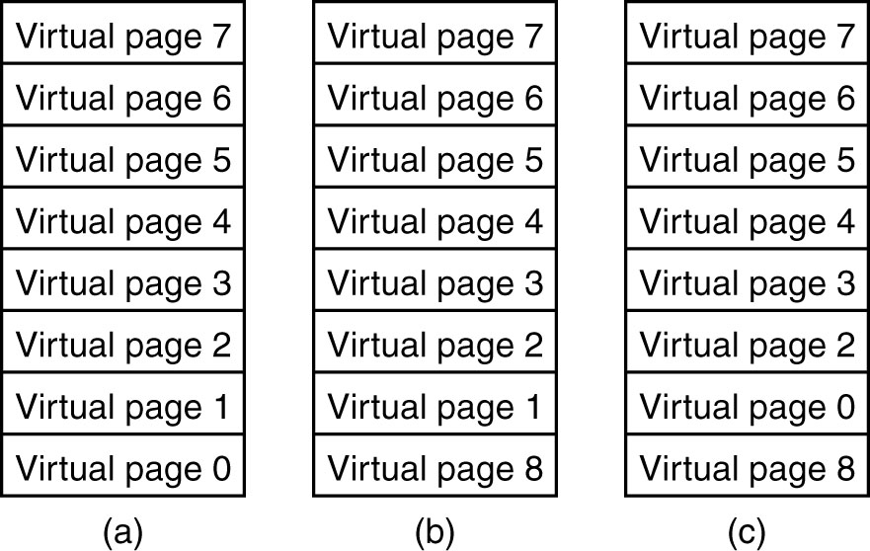
Failure of the LRU Algorithm

Slide 26
The “Dirty Bit”
If a page to be replaced has not been changed, it can simply be discarded.
Otherwise, it must be written to disk before a new page can be brought in. (A time-consuming process.)
Many virtual memory systems implement a “dirty bit” in the page table.
It is set to zero when a page is first loaded into a page frame.
It is set to one when the page is modified.

Slide 27
Virtual Memory Tradeoffs
Disadvantages
Page file takes up space on disk
Paging takes up resources of the CPU
Paging takes time
Advantages
Programs share memory space
More programs can run at the same time
Programs can run even if they cannot fit into memory all at once
Process separation (memory space protection)

Slide 28
Memory Protection
If every program has the full logical address space available to it, then any address is valid and in the program’s address space.
So, there is no way for a program to generate an address that belongs to the OS or another program.
Problem: Sometimes a program needs access to memory owned by the OS.
Solution: Allow the OS to share some part of the virtual address space.

Slide 29
Some actual security stuff…
Reading stolen data

Slide 30
So you’ve stolen some data
Now you want to read it
Most applications “encrypt” their data

Slide 31
Three Major Areas
Symmetric key (classical) cryptography: Security depends upon a secret (the key) shared between sender and recipient
Hash functions: transform an input into a fixed-size output with properties that depend on the function.
Public key cryptography: Depends upon a pair of keys, one public and one private

Slide 32
Symmetric Key Cryptography
Encrypt by applying the key to the plaintext using an algorithm.
Decrypt by reversing the process using the same key and the inverse algorithm.
Mnemonic: symmetric, shared key and secret key are all the same thing and they all start with S.

Slide 33
Breakable Encryption
A cryptosystem is “breakable” if, with enough time and information, it can theoretically be “cracked.”
Either by determining the key or otherwise obtaining the plaintext.
We must assume the algorithm is known. (Kerckhoffs’ Principle.)
A cryptosystem that is breakable may require considerable effort. That is known as being “computationally secure.”

Slide 34
Key Strength and Security
Encryption is (now) a mathematical operation
The strength is in the key, not the algorithm! (Assume that the bad guys know the algorithm.) That is Kerckhoffs’ Principle.)
However, the algorithm must be free from “shortcut attacks.”
Keys should be long and random.
Keys are applied over blocks of data. Brute force attack: try all possible key combinations. 40-bit key: 240 combinations.
Notes:
August Kerckhoffs – 19th Century French cryptographer.
Also” Shannon’s maxim: The enemy knows the system.

Slide 35
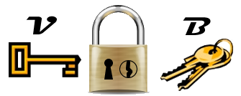
A Very Strange Lock
If locked with B, can only be unlocked with V. (B won’t unlock it.)
If locked with V, only unlocked with B.
So, B and V are inverses of one another with respect to this lock.
Notes:
This lock must be locked with a key; just snapping the hasp will not do.

Slide 36
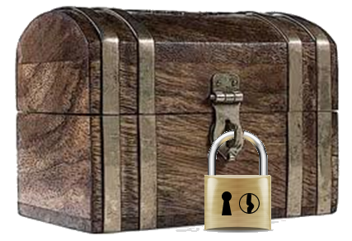
Idea…
Give each of your friends a lock and a B key
You keep the only V key.
Your friends can send you a locked box (locked with the B key) that only you can open because you have the only V key.
Notes:
Note: Other friends, with key B, cannot open the lock. So, it doesn’t matter how many people have B keys.

Slide 37
Public Key Cryptography
Also known as “asymmetric key cryptography.”
Encrypt with one key (publicly available)
Decrypt with a different key, known only to the recipient.
How? Trapdoor functions! Functions that are easy to compute, but for which the inverse is intractable.
293 × 307 is easy. Find the prime factors of 89,851!
Now try finding prime factors of a 100-digit number.

Slide 38
Public Key Cryptography
With public key cryptography, one creates a pair of keys, k_{v} (private) and k_{b} (public).
A ciphertext message, C is formed from a plaintext message M: C = f(k_{b},M)
Deriving M from C and k_{b} is intractable.
Deriving k_{v} from k_{b} is intractable.
However, M=f(k_{v},C) is straightforward to compute, but computationally intensive.

Slide 39
Locking with the Private (V) Key
If I lock a chest with the private (V) key…
Anyone with a public (B) key can open it…
But I am the only one who could have sent the contents because only I have the private (V) key. The contents are digitally signed!

Slide 40
Public Key Digital Signature
Public key cryptography works both ways; the keys are inverses of one another!
Bob encrypts a message with his private key
Anyone can decrypt it using Bob’s public key.
Only Bob could have encrypted it, so, it is “signed” by Bob.
Uhhh, but anyone can decrypt it; there is no confidentiality. (This is exactly analogous to a handwritten signature.)
Notes:
For the RSA algorithm and some others.
It is analogous if you believe that handwritten signatures are distinctive. Anyone can read a handwritten signature, but only one person could have written it.

