Slide 1
Ethical Hacking
Module 5

Slide 2
In the news…
Pentest gone awry
Dallis County, Iowa
https://www.scmagazine.com/home/security-news/vulnerabilities/pen-test-gone-awry-coalfire-staffers-arrested-for-burglary/

Slide 3
Social engineering
The use of deception to manipulate individuals
Targets the most vulnerable component of the network
Main goal is to gather information that can expose vulnerabilities in a network
Notes:
(in the context of information security) the use of deception to manipulate individuals into divulging confidential or personal information that may be used for fraudulent purposes.

Slide 4
6 key principles
Reciprocity
Commitment and consistency
Social proof
Authority
Liking
Scarcity
Notes:
Reciprocity – People tend to return a favor, thus the pervasiveness of free samples in marketing. The good cop/bad cop strategy is also based on this principle.
Commitment and consistency – If people commit, orally or in writing, to an idea or goal, they are more likely to honor that commitment because they have stated that that idea or goal fits their self-image. Even if the original incentive or motivation is removed after they have already agreed, they will continue to honor the agreement. An example is marketers who make the user close popups by saying “I’ll sign up later” or "No thanks, I prefer not making money”.
Social proof – People will do things that they see other people are doing.
Authority – People will tend to obey authority figures, even if they are asked to perform objectionable acts.
Liking – People are easily persuaded by other people whom they like.
Scarcity – Perceived scarcity will generate demand. For example, saying offers are available for a "limited time only" encourages sales.

Slide 5
Main tactics used by social engineers when profiling a person, including:
Persuasion
Intimidation
Coercion
Extortion
Blackmailing

Slide 6
Step 1 pick your target
Social engineering is performed on people
So we need a victi..*ahem* “subject”
So, out of the 7,000,000,000,000(+/-) people out there, which one do we pick?

Slide 7
hypothetically
Let us assume we have been making money
How we do it is up to us
Our target is a large accounting firm
They primarily handle tax and investment paperwork for small/moderate businesses
They have several secretaries, CPAs, and network/IT technicians on staff

Slide 8
Good target Qualifications?

Slide 9
Stage 1- information gathering
Learn about the people
Learn about the organization
Learn about the computer system(s)

Slide 10
Shoulder surfing
Literally looking over the victim’s shoulder
Dumpster diving
Or as the reading says: “Dumpster driving”

Slide 11
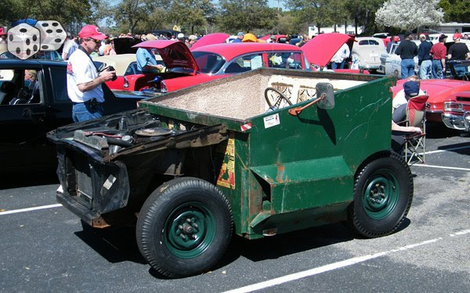

Slide 12
Shoulder surfing
Literally looking over the victim’s shoulder
Dumpster diving
Or as the reading says: “Dumpster driving”

Slide 13
Things to look for in a dumpster
Financial reports
Interoffice memos
Discarded computer programs
Company organizational charts showing managers’ names
Resumes of employees
Company policies or systems and procedures manuals
Professional journals or magazines
Utility bills
Solicitation notices from outside vendors
Regional manager reports
Quality assurance reports
Risk management reports
Minutes of meetings
Federal, state, or city reports

Slide 14
Meet in person
Some people become “friends” with the victim
How often do to complain about “X” to your friends?

Slide 15
Ok…so
We’ve gotten to know what people do which jobs
We might have even gotten a look around the building for ourselves
So it’s time to talk strategy

Slide 16
Ok…so
We’ve gotten to know what people do which jobs
We might have even gotten a look around for ourselves
So it’s time to talk strategy
Remember the:
Persuasion
Intimidation
Coercion
Extortion
Blackmailing

Slide 17
How?
Do we go after one specific person or a group?
Do we focus on a specific group?
People over 55
Students
Underpaid/overworked secretaries
Do we do this in person or remotely
By letter
Phone
Email
Text message
Notes:
Well, we are IT people, meaning we like to make the machines do as much of our work as possible

Slide 18
One popular technique
Phishing
A phake yet “convincing” request for inphormation
Generally not phocased at an individual
Idea: let the law oph averages work phor us

Slide 19
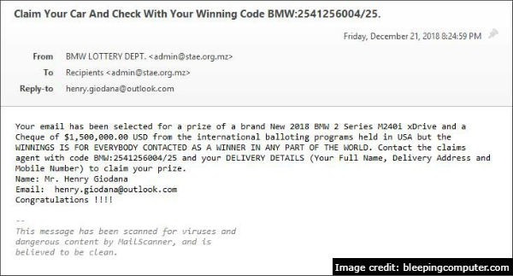

Slide 20
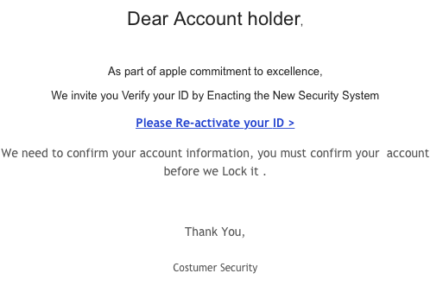

Slide 21
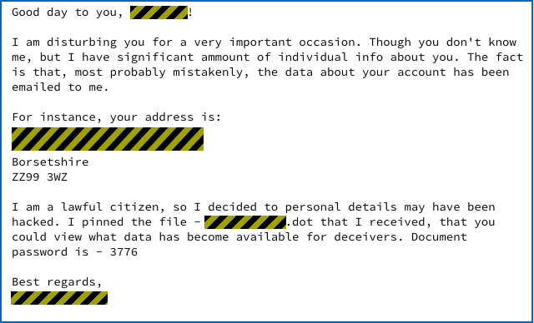

Slide 22
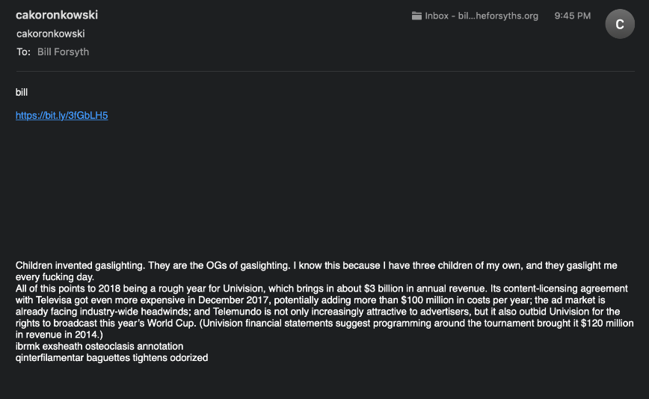
And sometimes bizarre…

Slide 23
Now then
Assuming we send enough of these emails to enough people…
What are the chances that someone:
Naive user
Non-native English speaker
Mentally handicapped
Child
Will click the link and type in their information?

Slide 24
We can also go spear phishing
Target specific people
Students AT a specific school
Employees at a specific company
Users of a specific service

Slide 25
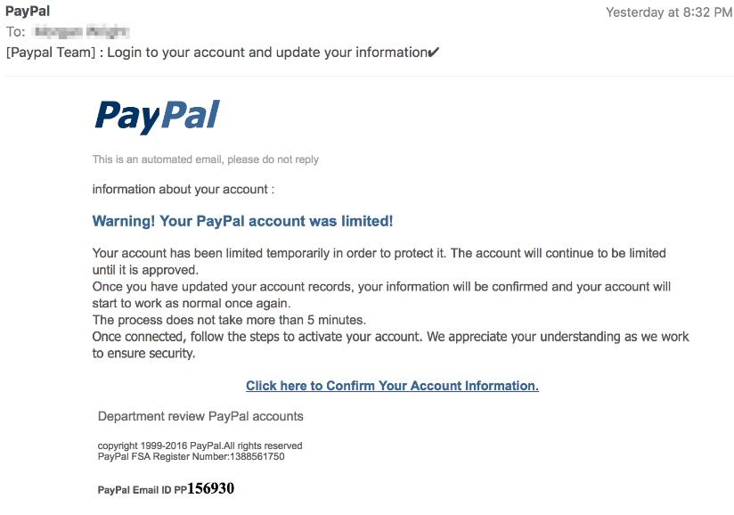

Slide 26
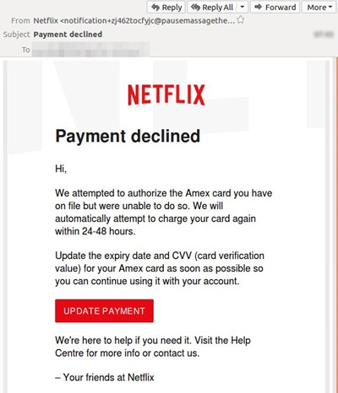

Slide 27
pretexting
The act of creating and using an invented scenario to engage a targeted victim
I.E. An elaborate lie
Most often involves some prior research or setup
Notes:
the act of creating and using an invented scenario (the pretext) to engage a targeted victim in a manner that increases the chance the victim will divulge information or perform actions that would be unlikely in ordinary circumstances. An elaborate lie, it most often involves some prior research or setup and the use of this information for impersonation (e.g., date of birth, Social Security number, last bill amount) to establish legitimacy in the mind of the target.

Slide 28
Water holing
Capitalizes on the trust users have in websites they regularly visit
The victim feels safe to do things they would not do in a different situation
Notes:
A wary person might, for example, purposefully avoid clicking a link in an unsolicited email, but the same person would not hesitate to follow a link on a website they often visit. So, the attacker prepares a trap for the unwary prey at a favored watering hole.

Slide 29
baiting
Real world Trojan horse
Attacker creates media with curiosity-piquing labels
Attacker then leaves the infected media where people will find them
CDs, USB flash drives, etc.

Slide 30
Quid pro quo
something for something
An attacker calls random numbers at a company, claiming to be calling back from technical support
Eventually they’ll hit someone with a legitimate problem
Who is grateful that someone is calling back

Slide 31
Tailgating
Piggybacking
Walk in through the front door on someone else’s coat tales
A TurtleBot tries to gain access to a secure facility with an “ingenious” plan

