Slide 1
Embedded os
You’ll see in the real world

Slide 2
CISCO ios

Slide 3
Cisco ios
Cisco Internetwork Operating System
Developed in the 1980s
For routers with less than 256kB of RAM
Used on many Cisco routers, switches, and firewalls
Originally a stand alone kernel
Now runs on a modified Linux kernel

Slide 4
interface
Primary interface is a CLI
Access through
SSH
Telnet
Serial
Has a fixed set of commands
Has privileged “modes” (used to restrict specific commands)

Slide 5
Architecture
Monolithic kernel architecture
All processes have direct hardware access to reduce CPU time

Slide 6
tangent
Notes:
By Golftheman - http://en.wikipedia.org/wiki/Image:OS-structure.svg, Public Domain, https://commons.wikimedia.org/w/index.php?curid=4397379

Slide 7
Architecture
Monolithic kernel architecture
All processes have direct hardware access to reduce CPU time
No memory protection
Run-to-completion process scheduling
No pre-emption
No paging or swapping
In the event of an IOS crash, the operating system automatically reboots and reloads the saved configuration
More on this later

Slide 8
Security and vulnerabilities
IOS devices can support centralized login
For emergency purposes, there is often a local account
Because IOS needs the plaintext password, all local passwords are weakly encrypted
And thus easily decrypted
But how do we get the encrypted password?
Notes:
Because IOS needs to know the cleartext password for certain uses, (e.g., CHAP authentication) passwords entered into the CLI by default are weakly encrypted
In computing, the Challenge-Handshake Authentication Protocol (CHAP) authenticates a user or network host to an authenticating entity. That entity may be, for example, an Internet service provider.

Slide 9
Running vs start-up config
IOS has two configurations:
Running
Start-up
The running configuration is stored in RAM
Volatile
The startup configuration is stored in NVRAM
Non-Volatile

Slide 10
config
Any changes made in the CLI effect the running config
When the running config is saved, IOS dynamically builds a text file with the CLI commands necessary to achieve the running configuration
This file becomes the startup config

Slide 11
example
!
version 12.3
no service pad
service timestamps debug datetime msec
service timestamps log datetime msec
no service password-encryption
!
hostname retail
!
boot-start-marker
boot-end-marker
!
enable password cisco123
!
username jsomeone password 0 cg6#107X
aaa new-model
!
aaa group server radius rad_eap
server 10.0.1.1 auth-port 1812 acct-port 1813
!

Slide 12
example
!
version 12.3
no service pad
service timestamps debug datetime msec
service timestamps log datetime msec
no service password-encryption
!
hostname retail
!
boot-start-marker
boot-end-marker
!
enable password cisco123
!
username jsomeone password 0 cg6#107X
aaa new-model
!
aaa group server radius rad_eap
server 10.0.1.1 auth-port 1812 acct-port 1813
!

Slide 13
example
!
version 12.3
no service pad
service timestamps debug datetime msec
service timestamps log datetime msec
no service password-encryption
!
hostname retail
!
boot-start-marker
boot-end-marker
!
enable password cisco123
!
username jsomeone password 0 cg6#107X
aaa new-model
!
aaa group server radius rad_eap
server 10.0.1.1 auth-port 1812 acct-port 1813
!

Slide 14
Just BTW
Every device needs a local startup config
Also…
Most config files are archived for backup purposes

Slide 15
Apple iOS

Slide 16
ios
Released in 2007
Unix-like
Based on the XNU Darwin Kernel (BSD)
Written in:
C, C++, Objective-C, Swift
Notes:
Objective-C is a general-purpose, object-oriented programming language that adds Smalltalk-style messaging to the C programming language.

Slide 17
Architecture
XNU
Originally developed by NeXT for the NeXTSTEP operating system
Hybrid kernel
Features:
Memory protection
Message Processing
Multiprocessing support

Slide 18
Security
Secure Boot
Secure Enclave
Passcode
Touch ID
Address Space Layout Randomization
Non-Executable Memory
Encryption
App Security
Network Security
Notes:
Before fully booting into iOS, there is low-level code that runs from the Boot ROM. Its task is to verify that the Low-Level Bootloader is signed by the Apple Root CA public key before running it.
The Secure Enclave is a coprocessor found in iOS devices that contain Touch ID or Face ID. It has its own secure boot process to ensure that it is completely secure. A hardware random number generator is also included as a part of this coprocessor. Each device's Secure Enclave has a unique ID that is given to it when it is made and cannot be changed. This identifier is used to create a temporary key that encrypts the memory in this portion of the system. The Secure Enclave also contains an anti-replay counter to prevent brute force attacks
iOS devices can have a passcode that is used to unlock the device, make changes to system settings, and encrypt the device's contents
When used, Touch ID only temporarily stores the fingerprint data in encrypted memory in the Secure Enclave, as described above. There is no way for the device's main processor or any other part of the system to access the raw fingerprint data that is obtained from the Touch ID sensor
Address Space Layout Randomization (ASLR) is a low-level technique of preventing memory corruption attacks such as buffer overflows. It involves placing data in randomly selected locations in memory in order to make it harder to predict ways to corrupt the system and create exploits. ASLR makes app bugs more likely to crash the app than to silently overwrite memory, regardless of whether the behavior is accidental or malicious
iOS utilizes the ARM architecture's Execute Never (XN) feature. This allows some portions of the memory to be marked as non-executable, working alongside ASLR to prevent buffer overflow attacks including return-to-libc attacks
One use of encryption in iOS is in the memory of the Secure Enclave. When a passcode is utilized on an iOS device, the contents of the device are encrypted. This is done by using a hardware AES 256 implementation that is very efficient because it is placed directly between the flash storage and RAM
iOS, in combination with its specific hardware, uses crypto-shredding when erasing all content and settings by obliterating all the keys in 'effaceable storage'. This renders all user data on the device cryptographically inaccessible
The iOS keychain is a database of login information that can be shared across apps written by the same person or organization.[170] This service is often used for storing passwords for web applications
Third-party applications such as those distributed through the App Store must be code signed with an Apple-issued certificate. In principle, this continues the chain of trust all the way from the Secure Boot process as mentioned above to the actions of the applications installed on the device by users. Applications are also sandboxed, meaning that they can only modify the data within their individual home directory unless explicitly given permission to do otherwise. There is a very extensive set of privacy controls contained within iOS with options to control apps' ability to access a wide variety of permissions such as the camera, contacts, background app refresh, cellular data, and access to other data and services. Most of the code in iOS, including third-party applications, runs as the "mobile" user which does not have root privileges. This ensures that system files and other iOS system resources remain hidden and inaccessible to user-installed applications.
iOS supports TLS with both low- and high-level APIs for developers. By default, the App Transport Security framework requires that servers use at least TLS 1.2. However, developers are free to override this framework and utilize their own methods of communicating over networks. When Wi-Fi is enabled, iOS uses a randomized MAC address so that devices cannot be tracked by anyone sniffing wireless traffic

Slide 19
App Store Bypass
Companies can apply to Apple for enterprise developer certificates
These can be used to sign apps such that iOS will install them directly
Notes:
These can be used to sign apps such that iOS will install them directly (sometimes called "sideloading"), without the app needing to be distributed via the App Store.
Circa January–February 2019, it emerged that a number of software developers were misusing enterprise developer certificates to distribute software directly to non-employees, thereby bypassing the App Store. Facebook was found to be abusing an Apple enterprise developer certificate to distribute an application to underage users that would give Facebook access to all private data on their devices. Google was abusing an Apple enterprise developer certificate to distribute an app to adults to collect data from their devices, including unencrypted data belonging to third parties. TutuApp, Panda Helper, AppValley, and TweakBox were abusing enterprise developer certificates to distribute apps that offered pirated software.

Slide 21
Android

Slide 22
Android
Released in 2008
Based on modified Linux Kernel
Written in
Java, C, C++

Slide 23
Architecture
Based on modified LST Linux Kernel
Meaning micro-kernel
The flash storage split into several partitions
/system
/data
Android device owners are not given root access
root access can be obtained by exploiting security flaws in Android
Notes:
/system for the operating system itself, and /data for user data and application installations.
Android device owners are not given root access to the operating system and sensitive partitions such as /system are read-only. Root access can be obtained by exploiting security flaws in Android, which is used frequently by the open-source community to enhance the capabilities of their devices

Slide 24
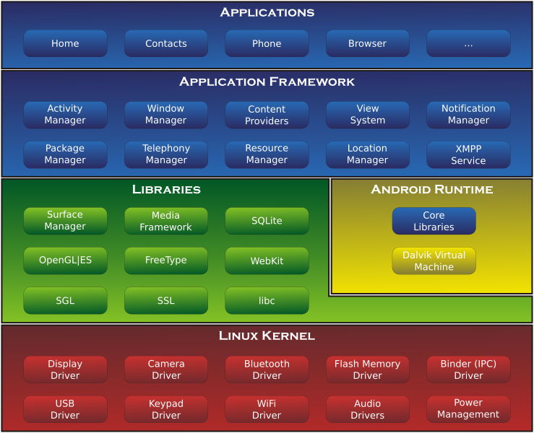

Slide 25
Security
Android's source code is released by Google under an open source license
Meaning many different (often incompatible) “flavors”
Rely on carriers for OS updates
Sandbox mode for applications
Notes:
In some cases it may not be possible to deny certain permissions to pre-installed apps, nor be possible to disable them. The Google Play Services app cannot be uninstalled, nor disabled.
In September 2014, Jason Nova of Android Authority reported on a study by the German security company Fraunhofer AISEC in antivirus software and malware threats on Android. Nova wrote that "The Android operating system deals with software packages by sandboxing them; this does not allow applications to list the directory contents of other apps to keep the system safe. By not allowing the antivirus to list the directories of other apps after installation, applications that show no inherent suspicious behavior when downloaded are cleared as safe. If then later on parts of the app are activated that turn out to be malicious, the antivirus will have no way to know since it is inside the app and out of the antivirus’ jurisdiction".

