Slide 1
Boolean Logic

Slide 2
Flow of Control
Sequential
  Execute instructions in order
Selection
  Execute different instructions depending on data
Method calls
  Transfer control to method, execute instructions in method, then return with or without a value
Looping
  Repeat a set of instructions for different data

Slide 3

A Flow Diagram
Start
Blame it on
someone else
Lay low and
keep hidden
Did you break
anything?
Yes
Yes
No
Yes
Have your
parents asked
about it?
Are you lying?
No
Are you passing
your classes?
No
No
Yes
Ask for $$
End
Notes:
Notice that every question resolves to a “yes’ or “no” answer

Slide 4
The Boolean
A bool is a something that resolves to true or false
You can get Boolean values several different ways
  Simple
  Complex
These bools will be used (later) to make decisions

Slide 5
Relational Operators
(for primitive data types)
Relational Operators
  > greater than
  < less than
  == equals
  != not equal
  >= greater than or equal
  <= less than or equal
Notice that all of these return us a true or false value

Slide 6
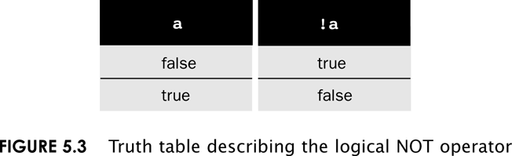
Not operator (!)
! – The “not” operator
  Inverts any Boolean value

Slide 7
Relational Operator Examples
Literal Example
  5 > 3 # true
  6 != 6 # false
  true == (4 <= 2) # false
  ‘c’ != ‘b’ # true
  !false # true
Variable Example
  num1 = 5;
  num2 = 7;
  result = num2 > num1;
  # Note: result is now true

Slide 8
Logical Operators
C/C++/Java/etc. | Python | Name
! | ! | Not
&& | and | And
|| | or | Or

Slide 9
&& and || Operators
These operators check for multiple conditions
&& (AND) needs both the left and the right to be true in order to return true
|| (OR) needs either one (or both) to be true to return true
Examples:
  ( (6 > 5) && ( ‘c’ == ‘b’) ) # false
  ( (6 > 5) && ( 7 < 9) ) # true
  ( (6 > 5) || ( ‘c’ == ‘b’) ) # true
  ( (6 > 6) || ( ‘c’ == ‘b’) ) # false

Slide 10
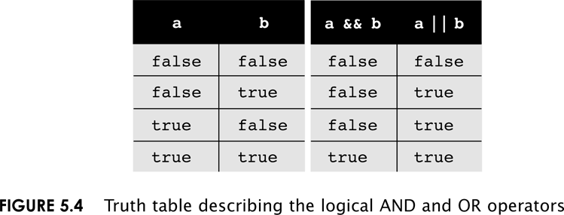
AND and OR Truth Table

Slide 11
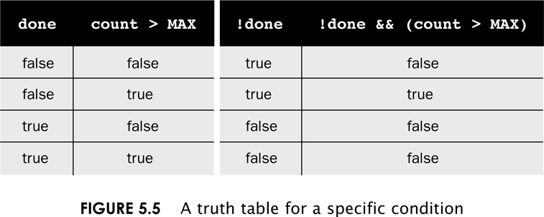
Truth Table Simplification

Slide 12
Relation Example
int x, y ;
x = 4;
y = 6;
EXPRESSION VALUE
x < y
x + 2 < y
x != y
x + 3 >= y
y == x
y == x+2
true
false
true
true
false
true

Slide 13
Syntax Warning!
Suppose we have three ints x, y, and z, and we want to test if x is less than both y and z. A common error is to express the condition this incorrect way:
x < y and z # Syntax error
Each operand of a logical operator must be a boolean expression. This is correct:
x < y and x < z

Slide 14
Operator Precedence
Precedence | Operator | Associativity
1 | () | Innermost First
2 | Unary operators: + - ++ -- ! (type) | Right to left
3 | * / % | Left to right
4 | + - | Left to right
5 | < <= > => | Left to right
6 | == != | Left to right
7 | && | Left to right
8 | || | Left to right
9 | = += -= *= /= %= | Right to left

Slide 15
Short-Circuit Evaluation
For any logical operator, the operands are evaluated left to right
If the result of the logical operation can be determined after evaluating the first operand, the second operand is not evaluated.
  If the first operand of an || is true, the result will be true
  If the first operand of an && is false, the result will be false

Slide 16
What is the value?
float x = 3, y = 4, z = 2;
EXPRESSION VALUE
1. (x > z) && (y > z)
2. (z > x) || (z > y)
3. (z > x) && (x < y)
4. !(x > y) || y + z >= x – z
5. !((x > y) || ((y + z) >= (x – z)))
true
false
False`
true
false

