Slide 1
Number Representation

Slide 2
The Question
Notes:
I want to pose a question, that our goal is to answer by the end of the lecture.

Slide 3
The Question
What value does the following number represent?
Notes:
I want to pose a question, that our goal is to answer by the end of the lecture.

Slide 4
The Question
What value does the following number represent?
01000001
Notes:
Is this binary? What makes you say so?
Isn’t 1,000,001 a valid number?

Slide 5
The Question
What value does the following number represent?
01000001
Binary? Decimal?
Notes:
So very quickly, the seemingly simple answer has become not quite so simple.

Slide 6
Number Bases
The “base” of a number simply tells you where to round.
Base 16: [0-F] (0, 1, 2, 3, 4, 5, 6, 7, 8, 9, A, B, C, D, E , F)
Base 10: [0-9] (0, 1, 2, 3, 4, 5, 6, 7, 8, 9)
Base 8: [0-8] (0, 1, 2, 3, 4, 5, 6, 7)
Base 2: [0-1] (0, 1)
So:
  01000001₁₆ = 16,777,217₁₀
  01000001₁₀ = 1,000,001₁₀
  01000001₈ = 262,145₁₀
  01000001₂ = 65₁₀
Notes:
So the same number can look very different depending on how it is written

Slide 7
So where does that leave us?
Well, it means we need some more context.
01000001 was stored in a computer’s memory?
  Does this help us?
Notes:
Well, yes and no.
How do computers represent numbers?
How do computers represent everything?

Slide 8
How do computers represent everything?
What “things” do computers represent?
  Numbers
  Letters
  Colors
  Sounds
Notes:
Computers do not “store” values. They store representations!

Slide 9
How do computers represent everything?
What “things” do computers represent?
  Numbers
    Integers
    Floating point
    Positive/Negative
  Letters
    English only?
    Upper case/Lower case
  Colors
  Sounds

Slide 10
How do computers represent everything?
So, if we know that 01000001 is a binary number…
  What does it represent?
Notes:
Is it an int? A float? Positive? Negative?

Slide 11
Negative Binary Numbers
How do we mark a number as negative?
Signed-magnitude
1’s Complement
2’s Complement
Notes:
Is it an int? A float? Positive? Negative?

Slide 12
Sign–magnitude
Uses the most significant bit as a sign indicator.
  “left” most bit is the most significant bit
    0 – positive
    1 – Negative
  Simple, but has drawbacks
  There are two zeros:
    00000000 (0)
    10000000 (−0)
Addition and subtraction require different behavior depending on the sign bit
Comparison requires inspecting the sign bit
The minimum negative number is −127

Slide 13
1’s Complement
Negative numbers are represented by inverting each bit of the number
Simpler to use!
  To add two numbers, do conventional binary addition
Like sign–magnitude, has two representations of 0:
  00000000 (+0)
  11111111 (−0)
Notes:
To see why this is necessary, consider the following example showing the case of the addition of −1 (11111110) to +2 (00000010):

Slide 14
2’s Complement
Negative numbers are represented by inverting each bit of the number and adding 1
  This solves the problems of multiple 0s and the need to add the resulting carry
All subtraction can be done by adding
  Add a negative number
    Makes the hardware simpler

Slide 15
Right, Ok, so…
Is 01000001 positive or negative?
Well…

Slide 16
Comparing the options
Decimal | Signed-magnitude | 1’s Complement | 2’s Complement
0 | 00000000/10000000 | 00000000/11111111 | 00000000
1 | 00000001 | 00000001 | 00000001
125 | 01111101 | 01111101 | 01111101
126 | 01111110 | 01111110 | 01111110
127 | 01111111 | 01111111 | 01111111
-127 | 11111111 | 10000000 | 10000001
-126 | 11111110 | 10000001 | 10000010
-125 | 11111101 | 10000010 | 10000011
-2 | 10000010 | 11111101 | 11111110
-1 | 10000001 | 11111110 | 11111111

Slide 17
Right, Ok, so…
Is 01000001 positive or negative?
If 01000001 is an integer, it is positive
  Also, assuming we are using one of the three methods mentioned

Slide 18
Right, Ok, so…
Is 01000001 positive or negative?
If 01000001 is an integer, it is positive
  Also, assuming we are using one of the three methods mentioned
But what else could it be?

Slide 19
Floating Point Representation
IEEE 754 standard
  Single precision: 32 bits
  Double precision: 64 bits
Encodes numbers represented by scientific notation
  E.g. 0.00000014 = 1.4×10⁻⁷

Slide 20

Floating Point Representation
The number is broken down into 4 parts:
  Sign: Indicates whether the number is positive or negative.
  Significand (Mantissa): Represents the precision bits of the number.
  Base: Usually 2 in binary systems.
  Exponent: Determines the scale of the number.
Notes:
https://upload.wikimedia.org/wikipedia/commons/thumb/d/d2/Float_example.svg/590px-Float_example.svg.png

Slide 21
Right, Ok, so…
Is 01000001 a float?
Most likely not
Unless..
Notes:
Most likely not, since it is too small
Unless it is part of a larger number

Slide 22
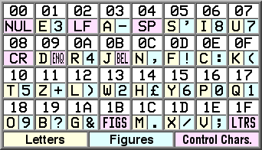
What about text?!
In the 1870s Émile Baudot invented the Baudot code
Each character in the alphabet is represented by five bits
  The rate of transmission is known as baud
Ver widely used in telegrams/teleprinters up until the 1960s
Notes:
(French pronunciation: [bodo])
CC BY-SA 3.0, https://commons.wikimedia.org/w/index.php?curid=179771
Big issue: no lower-case characters, limited special characters, and Latin alphabet only

Slide 23
Enter ASCII
American Standard Code for Information Interchange
  The first edition of the standard was published in 1963
Encodes each character as a seven-bit number
  Can represent lower case too
Lacks code-points for characters with diacritical marks
  So no résumé, jalapeño, or Beyoncé.
Used in many early computers well into the 1990s
Notes:
A “code-point” is a “thing” that can be represented by a code
Since 7 bits will fit easily into an 8-bit byte

Slide 24
Unicode
Began in the 1980s
Goal: Encompass the characters of all the world's living languages
Left the visual representation of characters to the software rendering the text
  Diacritical marks can be included
  Along with different typefaces
Designed to be backwards compatible
  The first 128 characters match the 128 ASCII characters

Slide 25
Right, Ok, so…
Is 01000001 a character?
Well…maybe
01000001 = 65
  It’s within the range of ASCII/UTF-8 (0-127)

Slide 26
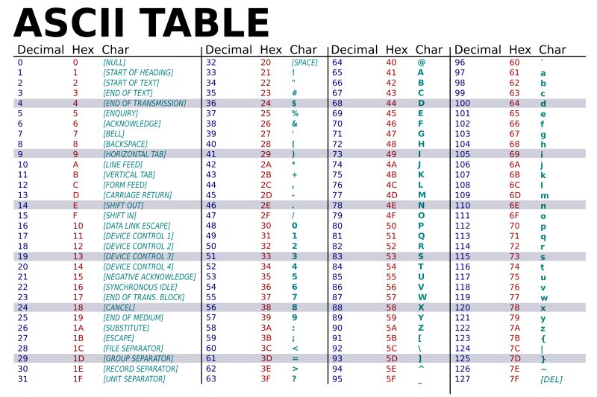
ASCII
Notes:
https://commons.wikimedia.org/wiki/File:ASCII-Table-wide.svg

Slide 27
Right, Ok, so…
Is 01000001 a character?
Possibly!
But how do we know for sure?
Notes:
Easy, we don’t!
Gotta have context

Slide 28
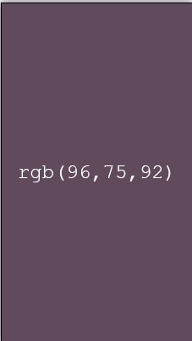
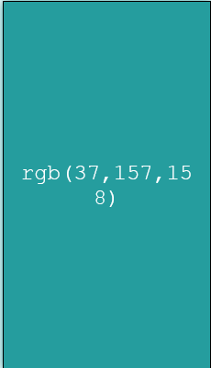
Storing Colors
Images are stores as a 2D grid of pixels
Pixels are comprised of three colors: red, green, and blue
Colors are represented as a set of three integers between 0 and 255
Notes:
https://www.wyzant.com/resources/answers/858948/explain-how-colour-data-is-stored-for-a-digital-image

Slide 29
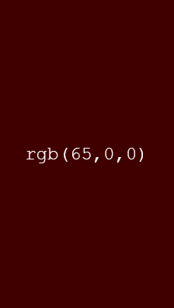
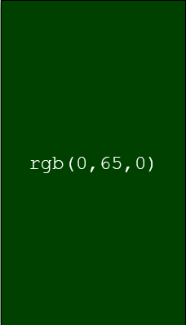
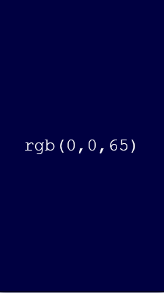
Storing Colors
Which means: 01000001 could be:
Or part of a larger color

Slide 30
Back to the start
So, what does 01000001 represent?
  An integer
  Part of a float
  A character
  A color
    Or a part of one
Context matters!

Slide 31
Datatypes
Datatypes provide the context:
  Integer
  Float
  Character
  String
  Boolean

