Slide 1
Iteration
(looping)

Slide 2
Flow of Control
Sequential
  Execute instructions in order
Selection
  Execute different instructions depending on data
Looping
  Repeat a set of instructions for different data
Method calls
  Transfer control to method, execute instructions in method, then return with or without a value

Slide 3
Iteration
Often we have code that performs the same task multiple times
  We could just “copy-paste”
    Makes program large
    Time consuming
    May need to be corrected in many places
Repetition structure: repeats the same code with different data

Slide 4
The while Loop: a Condition-Controlled Loop
while loop: while condition is true, do something
  Two parts:
    Condition tested for true or false value
    Statements repeated if condition is true
  General format:
    while condition:
    statements

Slide 5
Very similar to….
  if condition:
    Statement
    Statement

Slide 6
The while Loop: a Condition-Controlled Loop (cont’d.)
For a loop to stop executing, something must happen inside the loop to change the condition
Iteration: one execution of the body of a loop
while loop is known as a pretest loop
  Tests condition before performing an iteration
    Will never execute if condition is false to start with
    May require performing some steps prior to the loop

Slide 7
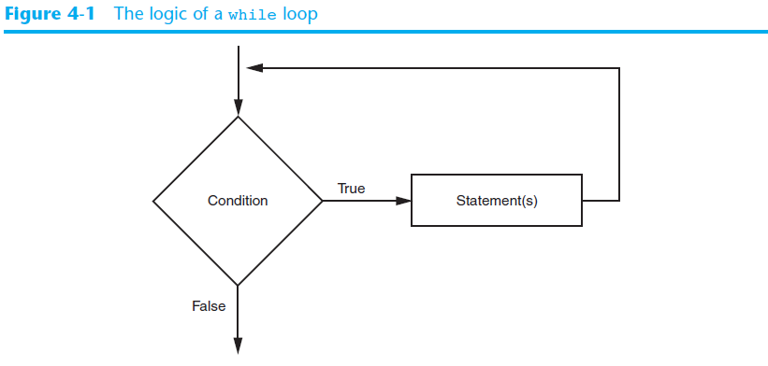
The while Loop: a Condition-Controlled Loop (cont’d.)

Slide 8
A Brief Cautionary Tale
num1 = 7*34
while num1 != 0:
  print(num1)
  num1 = num1 + 1
Based on our own extensive knowledge of programming, what will the outcome of this program be?

Slide 9
Infinite Loops
Loops must contain within themselves a way to terminate
  Something inside a while loop must eventually make the condition false

Slide 10
The for Loop: a Count-Controlled Loop
Count-Controlled loop: iterates a specific number of times
  Use a for statement to write count-controlled loop
    Designed to work with sequence of data items
      Iterates once for each item in the sequence
    General format:
    for variable in [val1, val2, etc]:
    statements
    Target variable: the variable which is the target of the assignment at the beginning of each iteration

Slide 11
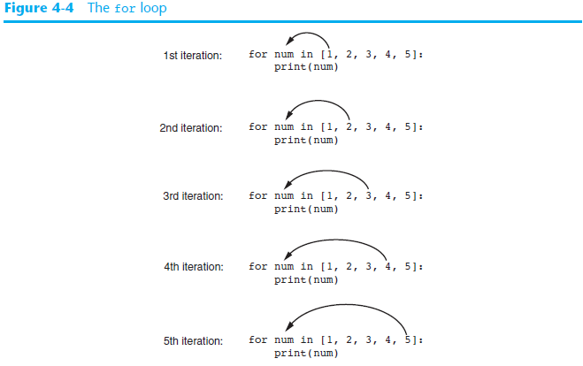

Slide 12
Syntax Breakdown
for num in [1, 2, 3, …, etc]:
statements
…
Means:
For each num in the list, loop
  Or
For each element in the list, which I will call num, loop

Slide 13
Using the range Function with the for Loop
The range function simplifies the process of writing a for loop
  range returns an iterable object
    Iterable: contains a sequence of values that can be iterated over
range characteristics:
  One argument: used as ending limit
  Two arguments: starting value and ending limit
  Three arguments: third argument is step value

Slide 14
Use
range(start, stop, step_value)
Start- the starting point of the range (inclusive)
Stop- the ending point (not inclusive)
Step_value- the distance between each value in the range
  If not included, is assumed to be 1

Slide 15
Example
What is the output for the following function?
range(0, 10)

Slide 16
Example
What is the output for the following function?
range(0, 10)
Answer:
[0, 1, 2, 3, 4, 5, 6, 7, 8, 9]

Slide 17
Example
What is the output for the following function?
range(0, 10, 1)

Slide 18
Example
What is the output for the following function?
range(0, 10, 1)
Answer:
[0, 1, 2, 3, 4, 5, 6, 7, 8, 9]

Slide 19
Example
What is the output for the following function?
range(0, 10, 2)

Slide 20
Example
What is the output for the following function?
range(0, 10, 2)
Answer:
[0, 2, 4, 6, 8]

Slide 21
Example
What is the output for the following function?
range(10, 0, -1)

Slide 22
Example
What is the output for the following function?
range(10, 0, -1)
Answer:
[10, 9, 8, 7, 6, 5, 4, 3, 2, 1]

Slide 23
Using the Target Variable Inside the Loop
Purpose of target variable is to reference each item in a sequence as the loop iterates
Target variable can be used in calculations or tasks in the body of the loop
  Example: calculate square root of each number in a range

Slide 24
Letting the User Control the Loop Iterations
Sometimes the programmer does not know exactly how many times the loop will execute
Can receive range inputs from the user, place them in variables, and call the range function in the for clause using these variables
  Be sure to consider the end cases: range does not include the ending limit

