Slide 1
Methods

Slide 2
Flow of Control
Sequential
  Execute instructions in order
Selection
  Execute different instructions depending on data
Looping
  Repeat a set of instructions for different data
Method calls
  Transfer control to method, execute instructions in method, then return with or without a value

Slide 3
Remember in algebra…
f(x) = 1.2x² + 6x + 1
f(4) = ?
f(9) = ?

Slide 4
Now, remember the ‘toolbox’
sqrt(x), print(x), int(x)
  Look familiar?

Slide 5
Now, remember the ‘toolbox’
sqrt(x), print(x), int(x)
  Look familiar?
Function == ‘Tool’

Slide 6
Introduction to Functions
Function: group of statements within a program that perform as specific task
  Usually one task of a large program
    Functions can be chained together in order to solve a larger problem
  Known as divide and conquer approach

Slide 7
Don’t worry about mnemonics
Function, Method, Subroutine
  While technically different, most often are used interchangeably
  Function: Procedural programming
  Method: Function, but operates on “objects”

Slide 8
Why Functions?
One long complex program
Divided into smaller tasks
statement
statement
statement
statement
statement
statement
statement
statement
statement
statement
statement
statement
statement
statement
statement
statement
statement
statement
statement
statement
def function1():
statement
statement
statement
statement
def function2():
statement
statement
statement
statement
def function3():
statement
statement
statement
statement
def function4():
statement
statement
statement
statement

Slide 9
Benefits of Modularizing a Program with Functions
The benefits of using functions include:
  Simpler code
  Code reuse
    write the code once and call it multiple times
  Better testing and debugging
    Can test and debug each function individually
  Faster development
  Easier facilitation of teamwork
    Different team members can write different functions

Slide 10
Defining and Calling a Function
Functions are given names
  Function naming rules:
    Cannot use key words as a function name
    Cannot contain spaces
    First character must be a letter or underscore
    All other characters must be a letter, number or underscore
    Uppercase and lowercase characters are distinct
  (optional)
    Function name should be descriptive of the task carried out by the function

Slide 11
Defining and Calling a Function (cont’d.)
Function definition: specifies what function does
  def function_name():
    statement
    statement

Slide 12
Defining and Calling a Function (cont’d.)
To execute the lines of code inside a function we Call it
  When a function is called:
    Interpreter jumps to the function and executes statements in the block
    Interpreter jumps back to part of program that called the function
      Known as function return

Slide 13
Indentation in Python
Each block must be indented
  You may use either tabs or spaces
    But not both
  Lines in block must begin with the same number of tabs or spaces
  Blank lines that appear in a block are ignored

Slide 14
Designing a Program to Use Functions
In a flowchart, function call shown as rectangle with vertical bars at each side
  Function name written in the symbol
  Typically draw separate flow chart for each function in the program
    End terminal symbol usually reads Return
Top-down design: technique for breaking algorithm into functions

Slide 15
Designing a Program to Use Functions (cont’d.)
Hierarchy chart: depicts relationship between functions
  AKA structure chart
  Box for each function in the program, Lines connecting boxes illustrate the functions called by each function
  Does not show steps taken inside a function
Use input function to have program wait for user to press enter

Slide 16
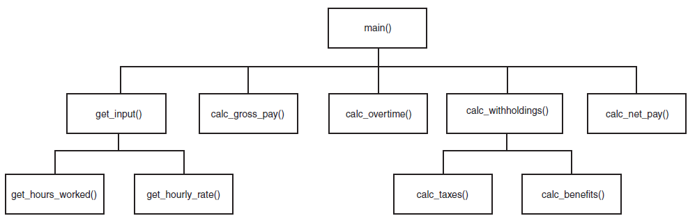
Designing a Program to Use Functions (cont’d.)

Slide 17
Passing Arguments to Functions
Argument: piece of data that is sent into a function
  Function can use argument in calculations
  When calling the function, the argument is placed in parentheses following the function name

Slide 18
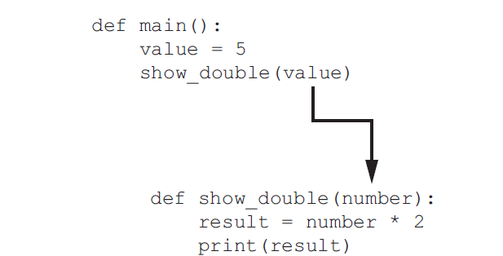
Passing Arguments to Functions (cont’d.)

Slide 19
Passing Multiple Arguments
Python allows writing a function that accepts multiple arguments
  Parameter list replaces single parameter
    Parameter list items separated by comma
Arguments are passed by position to corresponding parameters
  First parameter receives value of first argument, second parameter receives value of second argument, etc.

Slide 20
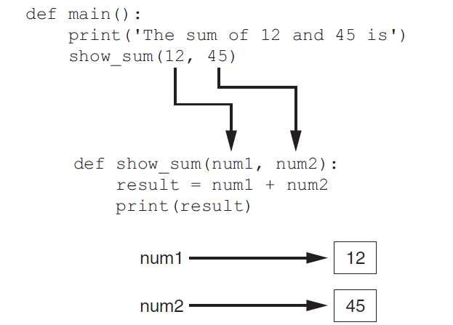
Passing Multiple Arguments (cont’d.)

Slide 21
Making Changes to Parameters
Changes made to a parameter value within the function can affect the argument depending on how it is passed
  Pass by value
  Pass by reference
*The rules for this change for every language

Slide 22
Pass by Value
The argument is copied, and the value is passed
  Any changes made by the function are lost when the function return
def main():
value = 99
change_me(value)
print(value) # value is still 99
def change_me(arg):
arg = 100
print(arg) # This value will be lost

Slide 23
Pass by Reference
A reference to the argument is passed.
  Any changes made by the function will replace the original value after the function returns
def main():
o = Object()
o.value = 99
change_me(o)
print(o.value) # The old value is gone
def change_me(arg):
o.value = 100 # The value is now change
print(o.value)

Slide 24
Local Variables
Local variable: variable that is assigned a value inside a function
  Belongs to the function in which it was created
    Only statements inside that function can access it, error will occur if another function tries to access the variable
Scope: the part of a program in which a variable may be accessed
  For local variable: function in which created

Slide 25
Local Variables (cont’d.)
Local variable cannot be accessed by statements inside its function which precede its creation
  English translation:
    You cannot use a variable before it is created
Different functions may have local variables with the same name
  Because each function is in a separate scope:
    Local variable names may be the same
    Argument names may be the same

Slide 26
Keyword Arguments
Keyword argument: argument that specifies which parameter the value should be passed to
  Position when calling function is irrelevant
  General Format:
  function_name(parameter=value)
Possible to mix keyword and positional arguments when calling a function
  Positional arguments must appear first
Useful for “default” argument values

Slide 27
Global Variables
Global variable: created by assignment statement written outside all the functions
  Can be accessed by any statement in the program file, including from within a function
  If a function needs to assign a value to the global variable, the global variable must be redeclared within the function
    General format: global variable_name
Use with caution

Slide 28
Global Variables (cont’d.)
Reasons to avoid using global variables:
  Global variables making debugging difficult
    Many locations in the code could be causing a wrong variable value
  Functions that use global variables are usually dependent on those variables
    Makes function hard to transfer to another program
  Global variables make a program hard to understand

Slide 29
Void Functions and Value-Returning Functions
A void function:
  Simply executes the statements it contains and then terminates.
A value-returning function:
  Executes the statements it contains, and then it returns a value back to the statement that called it.
    The input, int, and float functions are examples of value-returning functions.

Slide 30
Writing Your Own Value-Returning Functions
To write a value-returning function, you write a simple function and add one or more return statements
  Format: return expression
    The value for expression will be returned to the part of the program that called the function
  The expression in the return statement can be a complex expression, such as a sum of two variables or the result of another value- returning function

Slide 31
…phew
..Ok…So…Now what?

Slide 32
…phew
..Ok…So…Now what?
Well…Lets make our own function

Slide 33
…phew
..Ok…So…Now what?
Well…Lets make our own function
But first, we need to ask three questions

Slide 34
Three Questions
What is the function’s name?

Slide 35
Three Questions
What is the function’s name?
Does the function accept any arguments?
  If so, how many?

Slide 36
Three Questions
What is the function’s name?
Does the function accept any arguments?
  If so, how many?
Does the function return a value?
  If so, what?

Slide 37
Exercise 5A
Write a function the accepts no arguments…(pun intended)…and simply prints the string “Hello World” to the console.

Slide 38
Exercise 5B
Write a function that accepts two numbers as arguments, adds them together, and prints the result to the console

Slide 39
Exercise 5C
Write a function that accepts two numbers as arguments, adds them together and returns the result

Slide 40
Standard Library Functions and the import Statement
Standard library: library of pre-written functions that comes with Python
  Library functions perform tasks that programmers commonly need
    Example: sin, cos, tan
    Viewed by programmers as a “black box”
Some library functions built into Python interpreter
  Example: print, input, range
  To use, just call the function

Slide 41
Standard Library Functions and the import Statement
Modules: files that stores functions of the standard library
  Help organize library functions not built into the interpreter
  Copied to computer when you install Python
To call a function stored in a module, need to write an import statement
  Written at the top of the program
  Format: import module_name

Slide 42
Now Lets Do Something
Now for the practical part. Lets make and use our own toolbox.

Slide 43
Exercise 5D
Write a number guessing game.
The computer should pick a number at random from a range, e.g. 1-10 or 1-100. The user should then be prompted to guess a number and be told if his/her number is too high, too low, or correct until the user guesses the correct number.

Slide 44
Generating Random Numbers
Random number are useful in a lot of programming tasks
random module: includes library functions for working with random numbers
Dot notation: notation for calling a function belonging to a module
  Format: module_name.function_name()

Slide 45
Generating Random Numbers (cont’d.)
randint function: generates a random number in the range provided by the arguments
  Returns the random number to part of program that called the function
  Returned integer can be used anywhere that an integer would be used
  You can experiment with the function in interactive mode

