Slide 1
Classes and Objects

Slide 2
Procedural Programming
Procedural programming: writing programs made of functions that perform specific tasks
  Procedures typically operate on data items that are separate from the procedures
  Data items commonly passed from one procedure to another
  Focus: to create procedures that operate on the program’s data

Slide 3
Object-Oriented Programming
Object-oriented programming: focused on creating objects
Object: entity that contains data and procedures
  Data is known as data attributes and procedures are known as methods
    Methods perform operations on the data attributes
Encapsulation:
  combining data and code into a single object
  combining separate pieces of data that are relevant

Slide 4
Object-Oriented Programming (cont’d.)
Data
Data
Data
Data
Data
Methods
The outside world

Slide 5
Object-Oriented Programming (cont’d.)
Data hiding: object’s data attributes are hidden from code outside the object
  Access restricted to the object’s methods
    Protects from accidental corruption
    Outside code does not need to know internal structure of the object
Object reusability: the same object can be used in different programs
  Example: 3D image object can be used for architecture and game programming

Slide 6
An Everyday Example of an Object
Data attributes: define the state of an object
  Example: clock object would have second, minute, and hour data attributes
Public methods: allow external code to manipulate the object
  Example: set_time, set_alarm_time
Private methods: used for object’s inner workings

Slide 7
Classes
Class: code that specifies the data attributes and methods of a particular type of object
  Similar to a blueprint of a house or a cookie cutter
Instance: an object created from a class
  Similar to a specific house built according to the blueprint or a specific cookie
  There can be many instances of one class

Slide 8
Classes (cont’d.)
A class defines what type of data is stored
  As a blueprint dictates the number of rooms, but not their function
Classes may be specific
  A model of a physical entity
    Person, car, inventory item
  A model of a virtual entity
    PDF document, file, array

Slide 9
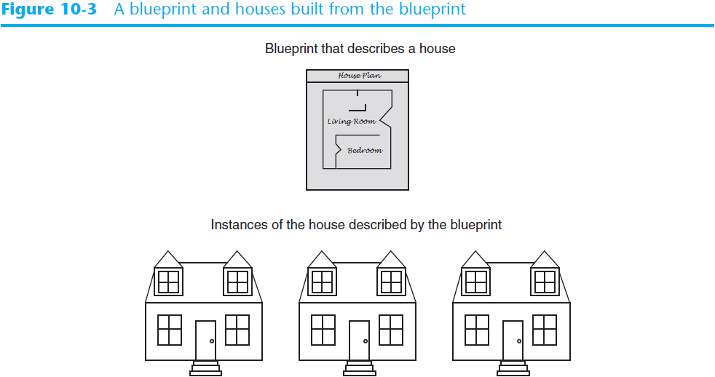
Classes (cont’d.)

Slide 10
Class Definitions
Class definition: set of statements that define a class’s methods and data attributes
  Format: begin with class Class_name:
    Class names often start with uppercase letter
  Method definition like any other python function definition
    self parameter: required in every method in the class – references the specific object that the method is working on

Slide 11
Class Definitions (cont’d.)
Initializer method: automatically executed when an instance of the class is created
  Initializes object’s data attributes and assigns self parameter to the object that was just created
  Format: def __init__ (self):
  Usually the first method in a class definition
    Also called a constructor

Slide 12
Class Definitions (cont’d.)
To create a new instance of a class call the initializer method
  Format: My_instance = Class_Name()
To call any of the class methods using the created instance, use dot notation
  Format: My_instance.method()
  Because the self parameter references the specific instance of the object, the method will affect this instance
    Reference to self is passed automatically

Slide 13
Hiding Attributes and Storing Classes in Modules
An object’s data attributes should be private*
  To denote this, place two underscores (__) in front of attribute name
    Example: __current_minute
Classes can be stored in modules
  Filename for module must end in .py
  Module can be imported to programs that use the class
*in Python, “private” is by convention only

Slide 14
The BankAccount Class – More About Classes
Class methods can have multiple parameters in addition to self
  These behave just like arguments to normal methods
  For __init__ :
    These arguments may be used to initialize attributes when an object is created
      Example: a BankAccount object is created with a balance
  For other methods:
    As with normal methods, arguments may contain necessary information
      Example: deposit method has amount to be deposited

Slide 15
The __str__ method
__str__ method: returns a string with a visual representation of the object
  User defined
    (i.e. us)
  Automatically called when the object is passed as an argument to the print function
  Automatically called when the object is passed as an argument to the str function

Slide 16
What is ‘self’?
When an object is created, it has its own set of attributes
If many instances of a class are created, each would have its own set of attributes
But there is only one method for all instances.
The ‘self’ argument specifies which object is being operated on
  I.e. self carries the scope

Slide 17
Accessor and Mutator Methods
Accessors and Mutators are the interface between the programmer and the object attributes
  Also known as “getters and setters”
Accessor methods:
  return a value from a class’s attribute without changing it
    Safe way for code outside the class to retrieve the value of attributes
  Assemble multiple attributes or compute a “derived” attribute
Mutator methods:
  store or change the value of a data attribute
  Provide “sanity checking” for new values

Slide 18
Passing Objects as Arguments
Methods and functions often need to accept objects as arguments
When you pass an object as an argument, you are passing a reference to the object
  Remember Pass by Reference?
The receiving method or function has access to the actual object
  Object data may be changed
    Sometimes this is good, other times, not so much

