Slide 1
Designing Classes

Slide 2
Finding the Classes in a Problem
When developing object oriented program, first goal is to identify classes
  Typically involves identifying the real-world objects that are in the problem
  Technique for identifying classes:
    Get written description of the problem domain
    Identify all nouns in the description, each of which is a potential class
    Refine the list to include only classes that are relevant to the problem

Slide 3
Finding the Classes in a Problem (cont’d.)
Get written description of the problem domain
  May be written by you or by an expert
  Should include any or all of the following:
    Physical objects simulated by the program
    The role played by a person
    The result of a business event
    Recordkeeping items

Slide 4
Finding the Classes in a Problem (cont’d.)
Identify all nouns in the description, each of which is a potential class
  Should include noun phrases and pronouns
  Some nouns may appear twice

Slide 5
Finding the Classes in a Problem (cont’d.)
Refine the list to include only classes that are relevant to the problem
  Remove nouns that mean the same thing
  Remove nouns that represent items that the program does not need to be concerned with
  Remove nouns that represent objects, not classes
  Remove nouns that represent simple values that can be assigned to a variable

Slide 6
Identifying a Class’s Responsibilities
A classes responsibilities are:
  The things the class is responsible for knowing
    Identifying these helps identify the class’s data attributes
  The actions the class is responsible for doing
    Identifying these helps identify the class’s methods
To find out a class’s responsibilities look at the problem domain
  Deduce required information and actions

Slide 7
Techniques for Designing Classes
UML diagram: standard diagrams for graphically depicting object-oriented systems
  Stands for Unified Modeling Language
General layout: box divided into three sections:
  Top section: name of the class
  Middle section: list of data attributes
  Bottom section: list of class methods

Slide 8
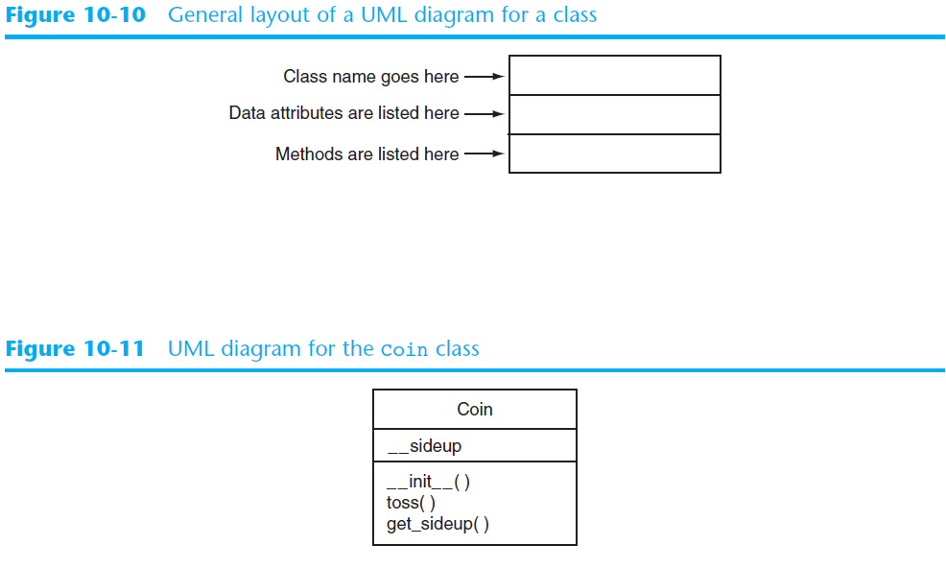
UML Diagram Example

