Slide 1
Sorting & Searching

Slide 2
“Big-O”
‘O’ stands for: “Order of Magnitude”
According to Wikipedia…
  “Big O notation is a mathematical notation that describes the limiting behavior of a function when the argument tends towards a particular value or infinity.”
In other words...
  Big O notation describes the complexity of your code using algebraic terms.

Slide 3

“Big-O”
$$O(n)$$
O – is the function
  i.e. the algorithm
n – the input size
  i.e. how many “things” your algorithm needs to process

Slide 4
Searching
Simple
  Sequential (linear) Search
Complex
  Binary Search

Slide 5
Sequential Search
Process of examining all values in a list (or array) until a target value is found or the search reaches the end of the list.
Sound familiar?
  Write a function that uses the following list:
    [“red”, “orange”, “yellow”, “green”, “blue”, “purple”]
  The program should prompt the user for a color and search the list to find that color. The program should either print out the index of the color or print “-1” to signify the color was not found.

Slide 6
Sequential Search
What is the time complexity for a Sequential Search?
  The “Big-O”

Slide 7
Sequential Search
What is the time complexity for a Sequential Search?
  The “Big-O”
How many elements are there?

Slide 8
Sequential Search
What is the time complexity for a Sequential Search?
  The “Big-O”
How many elements are there?
  This is n
How many times do you touch them?

Slide 9
Sequential Search
What is the time complexity for a Sequential Search?
  The “Big-O”
How many elements are there?
  This is n
How many times do you touch them?
If n increases, how does that affect the amount of work?

Slide 10
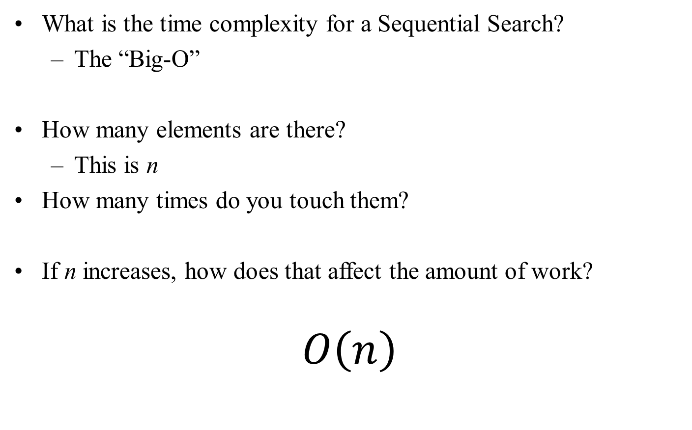
Sequential Search
What is the time complexity for a Sequential Search?
  The “Big-O”
How many elements are there?
  This is n
How many times do you touch them?
If n increases, how does that affect the amount of work?
$$O\left(n\right)$$

Slide 11
Binary Search
Only works on sorted list (array) BUT!
Provides amazing performance
1-10 – 5 guesses or less
1-100 – 7 guesses or less
1-4,000,000,000 - ~32 guesses or less

Slide 12
Binary Search
Start in middle element of array
  If we found it, great, otherwise…
  If target is < the element
    repeat process on left half (subarray)
  Else
    repeat process on right subarray

Slide 13
How many times can we chop this in half?
32 elements

Slide 14
How many times can we chop this in half?
32 elements
1 chop
16 elements
16 elements

Slide 15
How many times can we chop this in half?
32 elements
1 chop
16 elements
16 elements
1 chop
8 elements
8 elements
Total: 2 chops

Slide 16
How many times can we chop this in half?
32 elements
1 chop
16 elements
16 elements
1 chop
8 elements
8 elements
1 chop
4 elements
4 elements
Total: 3 chops

Slide 17
How many times can we chop this in half?
32 elements
1 chop
16 elements
16 elements
1 chop
8 elements
8 elements
1 chop
4 elements
4 elements
1 chop
2 elements
2 elements
Total: 4 chops

Slide 18
How many times can we chop this in half?
32 elements
1 chop
16 elements
16 elements
1 chop
8 elements
8 elements
1 chop
4 elements
4 elements
1 chop
2 elements
2 elements
1 chop
1 element
1 element
Total: 5 chops

Slide 19
Binary Search
What is the time complexity for a Binary Search?
  The “Big-O”
How many elements are there?
  This is n
How many times do you touch them?
If n increases, how does that affect the amount of work?
Notes:
With a binary search, each check reduces the total amount of work by half. Even if the amount of work doubles, that only adds one extra step

Slide 20
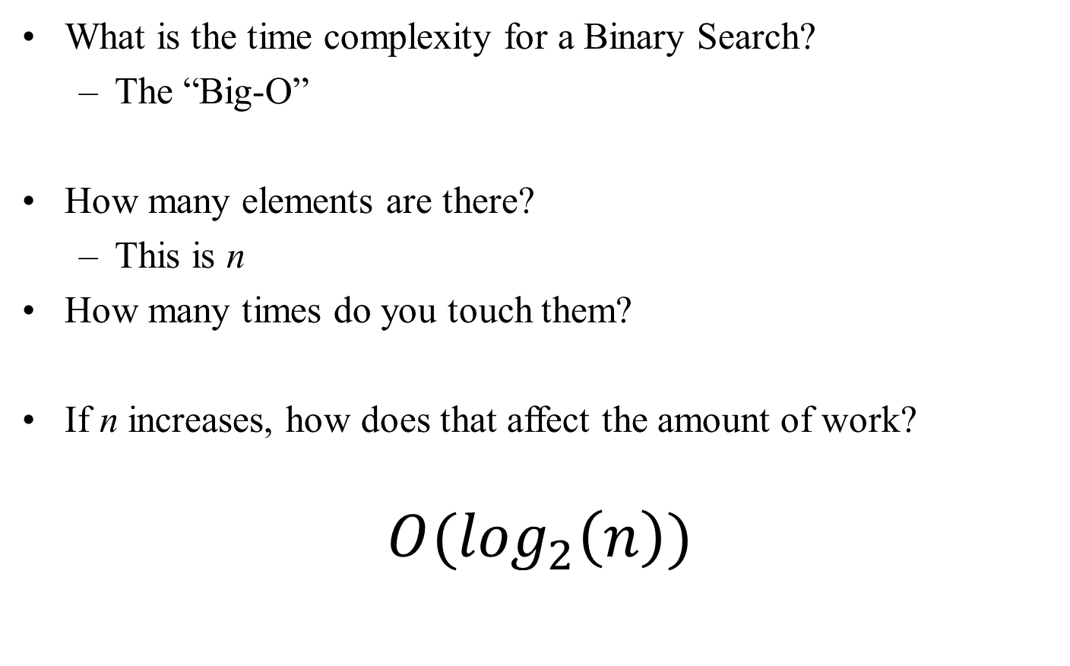
Binary Search
What is the time complexity for a Binary Search?
  The “Big-O”
How many elements are there?
  This is n
How many times do you touch them?
If n increases, how does that affect the amount of work?
$$O(\log_{2}\left(n\right))$$
Notes:
With a binary search, each check reduces the total amount of work by half. Even if the amount of work doubles, that only adds one extra step

Slide 21
How do we get a sorted list
We sort!
There are many sorting algorithms with varying complexity and performance
Let’s look at some simple ones
  Remember that simple doesn’t mean “best”

Slide 22
Bubble Sort
Bubble sort repeatedly examine elements and swap them if needed
This process “bubbles” elements to their correct positions in the list
These sorts are slow
  Large number of comparisons
  Large number of swaps
  Bubble Sort

Slide 23
Bubble Sort
for i in range(len(arr)):
for j in range(len(arr)-i-1):
if arr[j] > arr[j+1]:
# Swap
t = arr[j]
arr[j] = arr[j+1]
arr[j+1] = t
Notes:
Array name is “arr”

Slide 24
Selection Sort
Selection sort works as follows:
  Find the smallest value in the list and move to it to the first position in the list. This results in the first element being sorted
  Consider the unsorted part of the list and apply the same process in step 1
  Repeat step 2 on each un-sorted sub-list until the entire list is sorted
  Selection Sort

Slide 25
Selection Sort Working
Original list: 11 9 17 5 12
Find the smallest in the list and swap it with the first element
5 9 17 11 12
Find the next smallest in the unsorted sub-list and swap with second element. It is already in the correct place
5 9 17 11 12
Find the next smallest in the unsorted sub-list and swap it with the third element.
5 9 11 17 12
Repeat
5 9 11 12 17
Notice that when the unsorted sub-list is of length 1, we are done

Slide 26
Selection Sort
for i in range(len(sel)):
minPos = i
for j in range(i+1, len(sel)):
if (sel[j] < sel[minPos]):
minPos = j
if i != minPos:
t = sel[minPos]
sel[minPos] = sel[i]
sel[i] = t
Notes:
Array name is “sel”

Slide 27
Insertion Sort
Consider what you would do to sort a set of cards.
You continually maintain two sets – unsorted set and a sorted set.
For each card in the unsorted set, take it out of that set and place it correctly relative to the sorted set.
Insertion Sort

Slide 28
Insertion Algorithm
for i in range(len(ins)):
key = ins[i]
position = i
while position > 0 and key < ins[position - 1]:
ins[position] = ins[position - 1]
position = position -1
ins[position] = key

Slide 29
Why so many sorting algorithms?
Complexity
  Simple ones are faster to code, but slower to run
  More complex ones are slower to code, but faster to run
Different contexts
  Totally unsorted list?
  Partially sorted list?
  Maintaining an already sorted list?
Notes:
More complex algorithms are harder to understand and to code without making common mistakes
Testing, and bug hunting take time.

Slide 30
Comparison of Sorting Algorithms
Comparing:
  Bubble Sort
  Selection Sort
  Insertion Sort
Randomly generated unsorted array

Slide 31
Comparison of These Algorithms
Time (seconds)
N | Bubble | Select | Insert
256 | 0.01 | 0 | 0
512 | 0.03 | 0.01 | 0.02
1024 | 0.14 | 0.06 | 0.08
2048 | 0.57 | 0.24 | 0.32
4096 | 2.26 | 0.97 | 1.27
8192 | 9.01 | 3.76 | 5.2
16384 | 36.49 | 15.04 | 20.56
32768 | 142.1 | 60.43 | 84.67

Slide 32
Comparison of These Algorithms
Comparison Operations
N | Bubble | Select | Insert
256 | 32640 | 32640 | 33148
512 | 130816 | 130816 | 133642
1024 | 523776 | 523776 | 527470
2048 | 2096128 | 2096128 | 2094124
4096 | 8386560 | 8386560 | 8404222
8192 | 33550336 | 33550336 | 33590448
16384 | 134209536 | 134209536 | 134300098
32768 | 536854528 | 536854528 | 536052758

Slide 33
Comparison of These Algorithms
Array Accesses
N | Bubble | Select | Insert
256 | 131576 | 66276 | 512
512 | 528916 | 263672 | 1024
1024 | 2102492 | 1051616 | 2048
2048 | 8380504 | 4200412 | 4096
4096 | 33581564 | 16789448 | 8192
8192 | 134281568 | 67133404 | 16384
16384 | 537019268 | 268484560 | 32768
32768 | 2145814572 | 1073840048 | 65536

Slide 34
Comparison
Comparing:
  Bubble Sort
  Selection Sort
  Insertion Sort
Partially sorted array with the last 10 elements unsorted

Slide 35
Partially Sorted List Comparison
Time (seconds)
N | Bubble | Select | Insert
256 | 0 | 0 | 0
512 | 0.02 | 0.02 | 0
1024 | 0.03 | 0.03 | 0
2048 | 0.13 | 0.13 | 0
4096 | 0.54 | 0.49 | 0
8192 | 2.39 | 2.02 | 0.02
16384 | 9.87 | 8.04 | 0
32768 | 38.64 | 32.21 | 0.03
Notes:
Starting with a partially sorted list, with the last 10 elements unsorted

Slide 36
Partially Sorted List Comparison
Comparison Operations
N | Bubble | Select | Insert
256 | 32640 | 32640 | 2470
512 | 130816 | 130816 | 5452
1024 | 523776 | 523776 | 10632
2048 | 2096128 | 2096128 | 21812
4096 | 8386560 | 8386560 | 41926
8192 | 33550336 | 33550336 | 90218
16384 | 134209536 | 134209536 | 163262
32768 | 536854528 | 536854528 | 267370

Slide 37
Partially Sorted List Comparison
Array Accesses
N | Bubble | Select | Insert
256 | 70220 | 66276 | 512
512 | 272536 | 263500 | 1024
1024 | 1068816 | 1051488 | 2048
2048 | 4235880 | 4199852 | 4096
4096 | 16856972 | 16787040 | 8192
8192 | 67281108 | 67132376 | 16384
16384 | 268745596 | 268470440 | 32768
32768 | 1074243796 | 1073795360 | 65536

Slide 38
In Python However…
There is a short cut…
arr = [3, 7, 3, 9, 2, 8]
arr.sort()
print(arr)
…That’s it

